Slide 1

LOVE LEARNING. LOVE GOD. LOVE ONE ANOTHER.
“Let all that you do be done in love” (1Corinthians 16:14)

Slide 2

Welcome
Year 5

Slide 3
Our mission statement
At Poulton St Chad’s, we believe every child is a gift from God, blessed with their own gifts and talents. It is our mission to ensure children are safe, happy and can thrive. We aim to give our children a love for learning through our engaging curriculum and enrichment opportunities; a love for God within our distinctly Christian setting and a love for one another through our nurturing environment and inclusive relationships.
Every day we are guided by our biblical root: "Let all that you do be done in love." (1 Corinthians 16:14) and by our school motto: LOVE LEARNING. LOVE GOD. LOVE ONE ANOTHER.

Slide 4
Staff
Teacher: Mr Blackburn email: MRBlackburn@poultonstchadsce.lancs.sch.uk
Teaching Assistants: Mrs Hopwood and Mrs Parkinson
Family Support Worker: Mrs Hardy email: fsw@poultonstchadsce.lancs.sch.uk
Mrs Parkinson will be teaching Year 5 on a Tuesday afternoon and on a Wednesday each week.
Welcome to Year 5.

Slide 5

Practicalities
Please label all of your child’s uniform so it is easier to return if lost.
Your child should have a waterproof coat with a hood in school.
Packed lunch boxes should be labelled.
All children should have a named water bottle which contains only water.
Break times - KS2 pupils can buy fruit at the Junior Snack Bar (for 20p-40p) and toast is available on a Friday.

Slide 6
Practicalities continued
If someone different is picking your child up, please phone the office in advance so that they can inform their class teacher.
School starts at 8.55am. The gate opens at 8:40am for EYFS/KS1 and at 8.45am for KS2.
Please drop your child off at the outside door. If your child is late they must enter school via the office and a late form completed by an adult.
School finishes at 3.10 for EYFS/KS1 and 3.15pm for KS2.
If you child is walking home or meeting you at a different collection point then please email me and let me know.

Slide 7
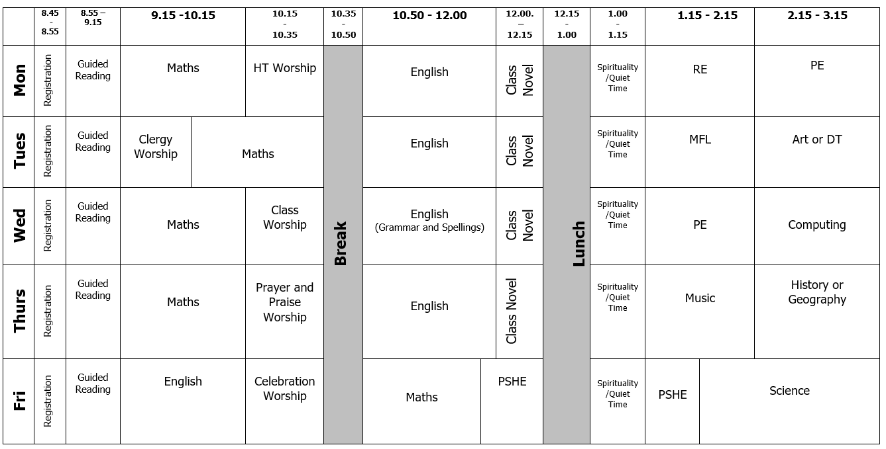

Daily Timetable

Slide 8
P.E.
In Year 5, your child will have P.E on Mondays and Wednesdays. Please ensure that they come dressed in P.E kit on these days.
Jewellery must not be worn for PE (earrings must be covered with plasters or taken out by the child)
Long hair must be tied back during school and all P.E lessons (only plain navy or blue hairbands are acceptable).

Slide 9
Behaviour
We have been reviewing our Behaviour Policy.
It is important that we work together as a partnership and that you understand how behaviour issues are dealt with at school.
Please can we ask that you sign your child’s planner after reading the Home School Agreement.
At St Chad’s we promote positive behaviour throughout and we have many positive reinforcements in place. For example in Year 5, we reward with a recognition board, marble jar, stickers and recognition cards. All children also receive house points.
Children are also chosen for Star Of The Week and Learner Of the Week Awards.
We always try to catch children being good!

Slide 10
Behaviour Continued
We now have regulation stations throughout school in case children need a few moments to try and regulate themselves.
If your child demonstrates poor behaviour in class, they will be given a warning. If their behaviour does not improve and they have moved through the different levels of the behaviour policy, then they will speak to their class teacher during ‘Quiet Time’ and parents will be contacted if this is repeated.
We ask that parents support the policy in school, which will be available on our website.
It is not helpful for parents to try and reverse a decision made in school.
Please contact the class teacher if you have any concerns about your child’s behaviour.

Slide 11
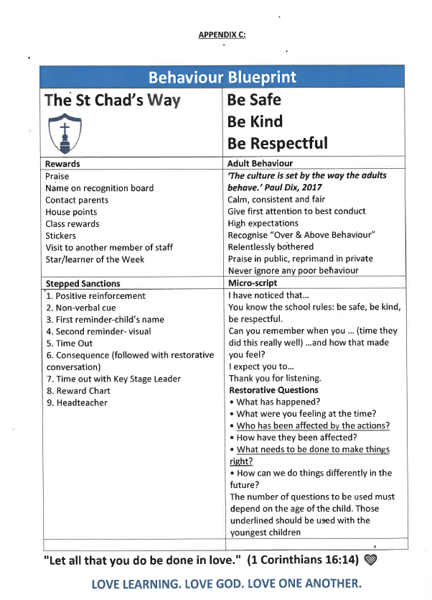

Slide 12
Home Learning
  Your child‘s Creative Home Learning Menu is available on the school website and on SeeSaw.
  The termly Newsletter explaining what the children will be learning about in each subject is also on the Year 5 page on the website and on SeeSaw.
  In Year 5, spellings and homework (one piece of English and one piece of Maths) are given on a Wednesday to be tested the following Wednesday.

Slide 13

Home Learning

Slide 14
Reading
  We expect that your child reads each night. Please sign their planner as soon as you have listened to them read so that we know whether they are having any difficulties and please send it into school each day.
  Children who haven’t had their planner signed at least three times per week will be given reading time in the Hub on a Friday breaktime.
  Comprehension skills are very important. Please discuss your child’s reading book with them and ask quiz questions about the text they have read.
  We now have a class text that we shall be reading for fun each half term.
  Our aim is to promote a love of reading.
  Classes will be given time each week to use our library.

Slide 15
Expected Outcomes for Year 5 in Reading
Use suffixes to understand meanings e.g. -ant, - ance, -ancy, -ent, ence, -ency, -ible, -able, -ibly, - ably.
Read and understand meaning of words on Y5/6 word list.
Use punctuation to determine intonation and expression when reading aloud to a range of audiences.
Explore themes within and across texts.
Analyse the conventions of different types of writing.
Check that the book makes sense to them and demonstrating understanding.

Slide 16
Expected Outcomes for Year 5 in Reading
Demonstrate active reading strategies.
Infer characters’ feelings, thoughts and motives from their actions and justifying inferences with evidence.
Predict what might happen from information stated and implied.
Re-read and read ahead to locate clues to support understanding.
Scan for key words and text marking to locate key information.
Summarise main ideas drawn from more than one paragraph and identifying key details which support this.
Identify how language, structure and presentation contribute to meaning.
Explain the effect on the reader of the authors’ choice of language.
Distinguish between statements of fact or opinion within a text.
Justify opinions and elaborating by referring to the text. (Point + Evidence + Explanation).

Slide 17
Expected Outcomes for Year 5 in Writing
Create complex sentences by using relative clauses with pronouns who, which, where, whose, when, that
Create and punctuate complex sentences using a variety of openers
Use devices (pronouns, conjunctions, etc) to build cohesion within a paragraph
Identify and use brackets and dashes
Using organisation and presentational devices
Use vocabulary and punctuation to enhance effects and clarify meaning.

Slide 18
Expected Outcomes for Year 5 in Writing
Ensuring consistent and correct use of tense throughout a piece of writing.
Proofreading for spelling and punctuation errors
Use dictionaries and thesaurus to check the spelling and meaning of words.
Spell most words containing Y5 spelling patterns/rules correctly.
Maintain legibility in joined handwriting when writing at speed.

Slide 19
Expected Outcomes for Year 5 in Maths
Read and write numbers to 100,000 and identify the value of the digits.
Add multiples of 1, 10, 100, 1000 and 10,000 within 100,000
Choose the correct operation and an appropriate strategy to + and – using knowledge of numbers to 100 and 1000.
Know that 10 tenths are equivalent to 1 one and that 1 is 10 times the size of 0.1. I know that 100 hundredths are equivalent to 1 one and that 1 is 100 times the size of 0.01
Recognise the place value of each digit in numbers with up to 2 decimal places, and compose and decompose numbers with up to 2 decimal places using standard and non-standard partitioning.

Slide 20
Expected Outcomes for Year 5 in Maths
Reason about the location of any number with up to 2 decimals places in the linear number system, including identifying the previous and next multiple of 1 and 0.1 and rounding to the nearest of each.
Divide 1 into 2, 4, 5 and 10 equal parts, and read scales/number lines marked in units of 1 with 2, 4, 5 and 10 equal parts.
Convert between units of measure, including using common decimals and fractions.
Multiply any whole number with up to 4 digits by any one-digit number using a formal written method.

Slide 21

Expected Outcomes for Year 5 in Maths (cont.)
Secure fluency in multiplication table facts, and corresponding division facts, through continued practice.
Apply place-value knowledge to known additive and multiplicative number facts (scaling facts by 1 tenth or 1 hundredth).
Multiply and divide numbers by 10 and 100; understand this as equivalent to making a number 10 or 100 times the size, or 1 tenth or 1 hundredth times the size.
Find factors and multiples of positive whole numbers, including common factors and common multiples, and express a given number as a product of 2 or 3 factors.

Slide 22
Expected Outcomes for Year 5 in Maths (cont.)
Divide a number with up to 4 digits by a one-digit number using a formal written method, and interpret remainders appropriately for the context.
Find equivalent fractions and understand that they have the same value and the same position in the linear number system.
Recall decimal fraction equivalents for ½, ¼
Compare angles, estimate and measure angles in degrees (°) and draw angles of a given size.
Compare areas and calculate the area of rectangles (including squares) using standard units.

Slide 23

Staying safe online

Slide 24
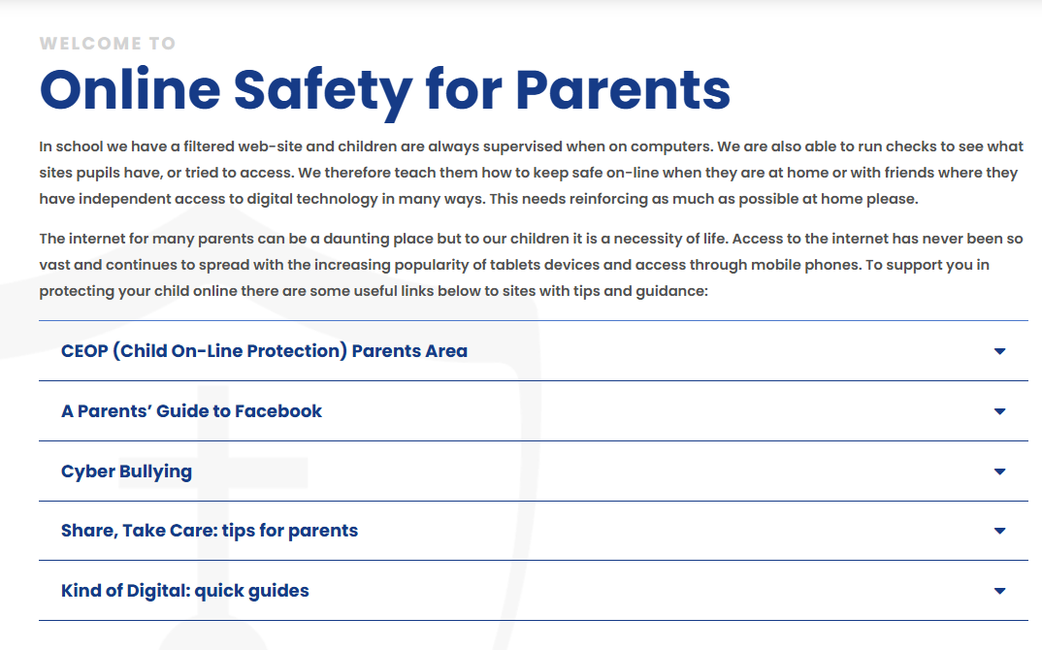
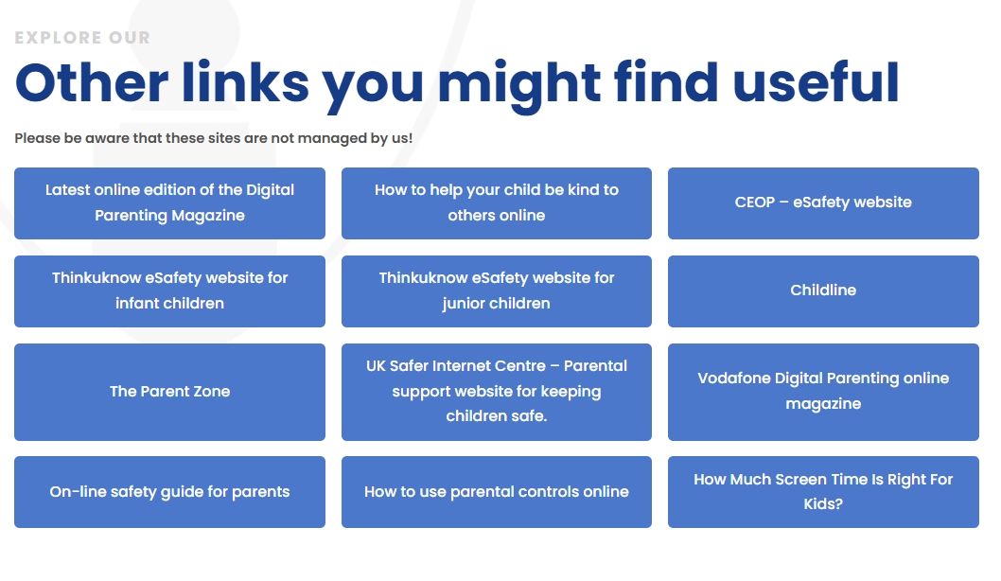
Staying safe online

Slide 25
Statutory Tests
There are no statutory tests in Y5.
We will carry out internal NFER papers this academic year.
We will be beginning to prepare for the SATS at the end of KS2 – developing skills and building confidence. We shall also assess the children with past SATS papers at the end of Y5 rather than NFER.

Slide 26
Extra Curricular Activities
There will continue to be a range of extra curricular activities available to Year 5.
I am running a Chess Club alongside Mr Graham during the autumn and spring terms.

Slide 27
KS2 Marking Policy
Symbol | Meaning
A | Objective Achieved
A- | Objective almost Achieved
* | Objective not achieved
____sp | Try spelling this word again
? | Does not make sense/ meaning is unclear
P | Find and include the missing punctuation on this line
// | A new paragraph is needed
“ | Speech marks are missing or used incorrectly.
^ | A word or letter has been missed out
 | Error to be checked
√ | Correct
. | Incorrect
√√ | Amazing!
→ | Next step
VF | Verbal Feedback

Slide 28
Reporting to Parents
Autumn Term - Parent’s Evening on:
Monday 20th and Thursday 23rd October 2025
Spring Term - Parent’s Evening on:
Monday 9th and Thursday 12th February 2026
Summer Term: End of Year Reports:
Wednesday 15th July 2026

Slide 29
Open door policy
St Chad’s operates an open door policy. If you have an issue or concern, please discuss it firstly with the class teacher.
First thing in the morning when the door is opened or when the teacher is seeing the children out at the end of day, is not always the most convenient time to discuss concerns.
You can call the office or send the teacher a message to make an appointment or ask for a call back.
The preferred method of communication is Seesaw. Any class related messages will be sent through this platform where as any whole school/sport messages will be sent through Parent App.
We will always respond within 48 hours.
In the rare event that the matter cannot be resolved with the teacher, please contact the Key Stage Leader (EYFS/KS1 Mrs Harwood or KS2 Mr Blackburn).
If there is still no resolution, then please contact Mrs Bitsakaki.

Slide 30
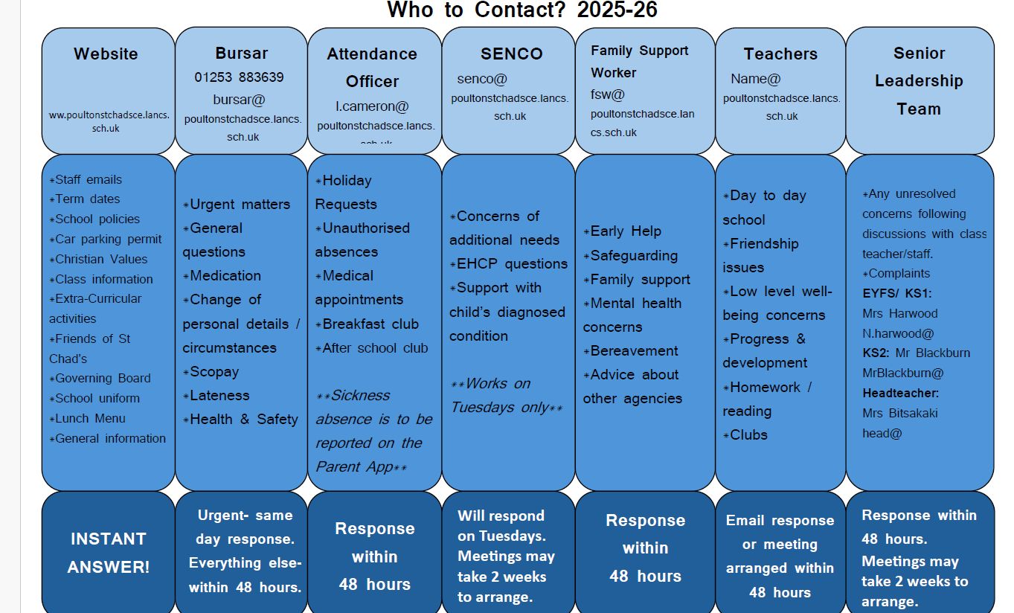
Who to contact

Slide 31
A day in the life of year 5
https://poultonstchadsce.lancs.sch.uk/wp-content/uploads/2025/09/Year-5-Video.mp4

Slide 32
Thank You
Any questions?
LOVE LEARNING. LOVE GOD. LOVE ONE ANOTHER.
“Let all that you do be done in love” (1Corinthians 16:14)
MrBlackburn@poultonstchadsce.lancs.sch.uk

