Slide 1
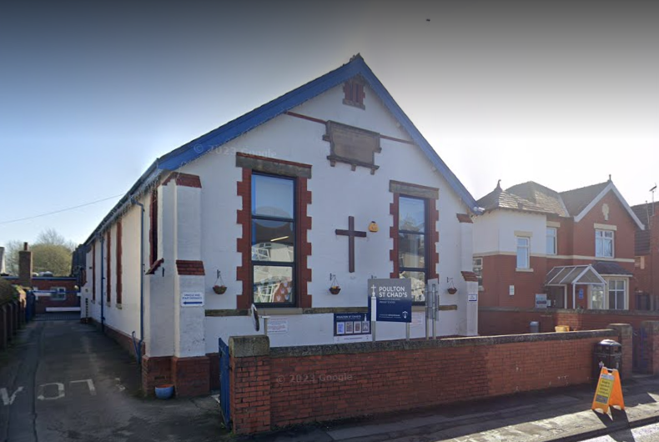
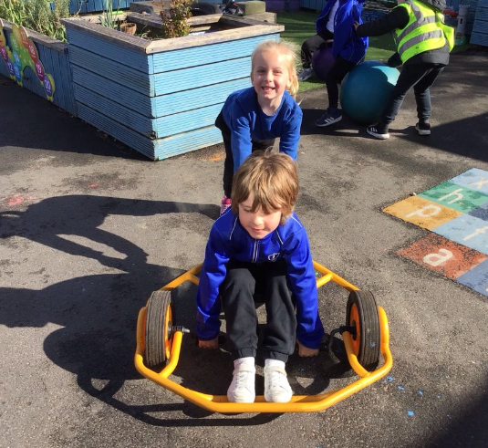
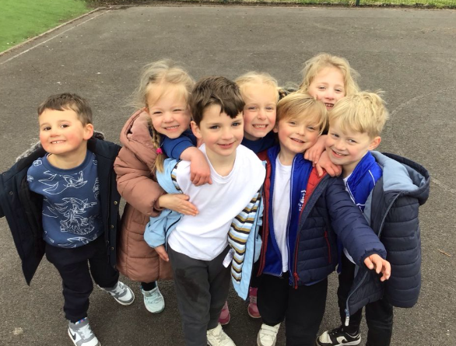
Welcome to Poulton St Chads Church of England Primary School

Slide 2

Our Mission Statement
At Poulton St Chad’s, we believe every child is a gift from God, blessed with their own gifts and talents. It is our mission to ensure children are safe, happy and can thrive. We aim to give our children a love for learning through our engaging curriculum and enrichment opportunities; a love for God within our distinctly Christian setting and a love for one another through our nurturing environment and inclusive relationships.
Every day we are guided by our biblical root: "Let all that you do be done in love." (1 Corinthians 16:14) and by our school motto: LOVE LEARNING. LOVE GOD. LOVE ONE ANOTHER.

Slide 3

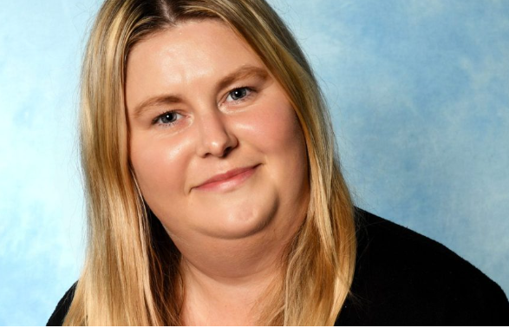

Class Teacher
Meet the EYFS team:
Mrs Archer
Classroom Teaching Assistant
Classroom Teaching Assistant and HLTA
Miss Dale
Miss Eggleston

Slide 4
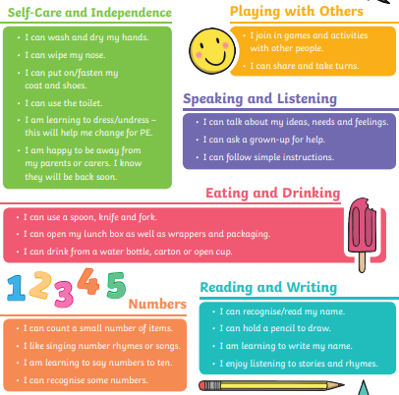
Here are a few things that you can do at home to help your child be ready for starting school.
At Poulton St Chads we strive to promote parental partnerships. We want the very best for your children and believe that working together will help your little ones achieve big things.

Slide 5
Every child is Unique!
Your Child Is Unique – How We Support Them in Reception
As your child begins their exciting journey in Reception, we want you to know that one of the most important things we believe in – and follow – is the idea that every child is unique.
This is part of the Early Years Foundation Stage (EYFS), the national framework we use to support children’s learning, development, and wellbeing.
What Does "The Unique Child" Mean?
It means we see – and value – your child as an individual. Every child has their own personality, interests, strengths, and way of learning. Some children love to talk and ask lots of questions, while others are quieter and like to watch and think before they join in. All of this is perfectly normal – and celebrated!
In Reception, we don’t expect children to all learn the same things at the same time or in the same way. Instead, we:
Get to know your child really well.
Find out what they enjoy and what motivates them.
Support their development at their own pace.
Help them feel safe, confident, and excited to learn.

Slide 6
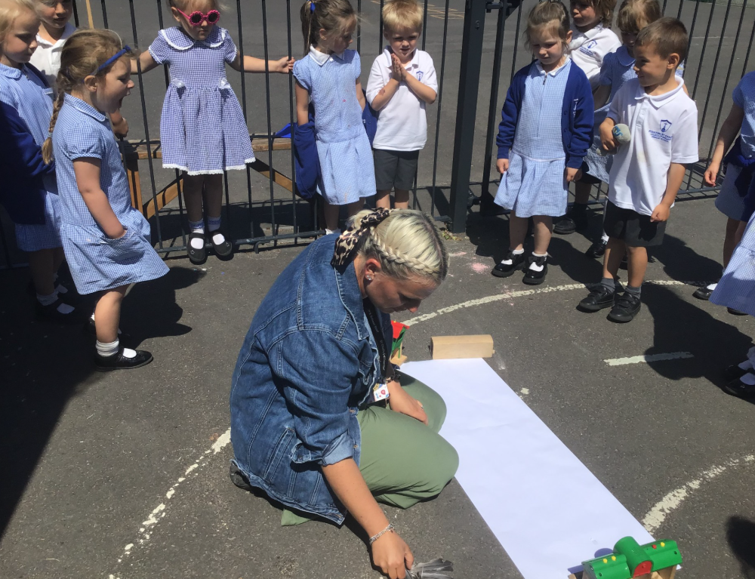
The Role of the Adults in Reception – Supporting Every Unique Child
In our Reception class, children are at the heart of everything we do. As adults, our role is to guide, support, and encourage every child as they grow, learn, and settle into school life.
How We Support Your Child
Reception is a big step for children, and our staff are here to make sure every child feels safe, happy, and confident. The adults in our class play a vital role in helping children:
Settle in and feel secure.
Build friendships and develop social skills.
Explore new learning experiences.
Gain independence.
Develop a love of learning through play and meaningful activities.
We do this by:
Observing and getting to know each child.
Planning activities that match their interests and stage of development.
Offering support when it’s needed – and encouraging independence when it’s appropriate.
Helping them manage big emotions and develop resilience.
We’re always nearby – whether to offer a hand, a smile, or just someone to talk to.

Slide 7
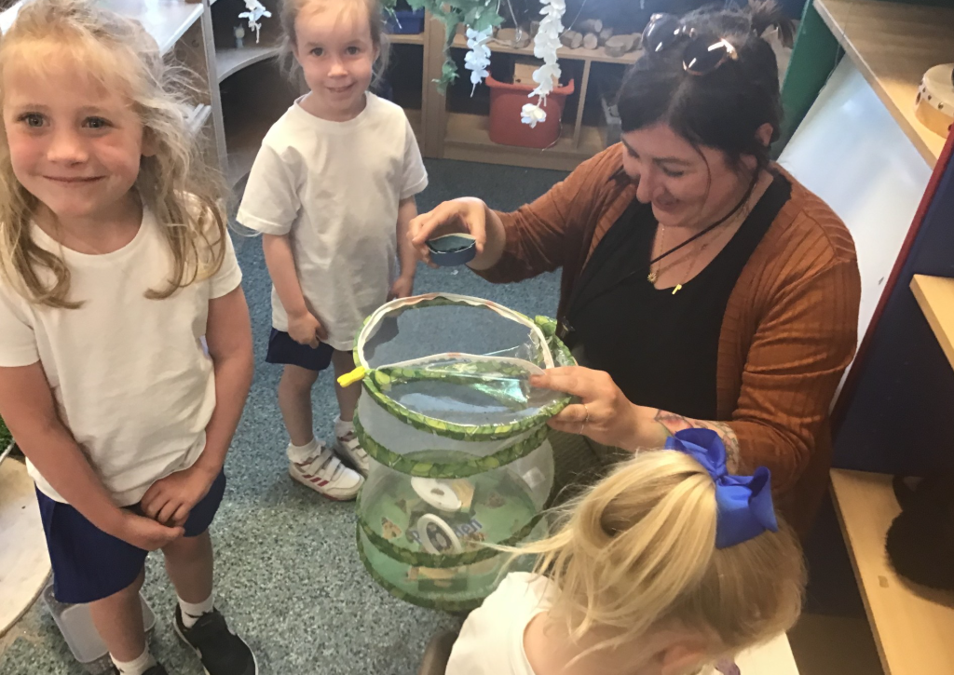
The Key Worker System in Reception
To help children feel especially secure and understood, we use a key worker system in our Reception class.
Each child is linked to a specific adult – their key worker – who builds a strong, trusting relationship with them. This doesn’t mean they only work with one adult, but it ensures your child has someone who:
Knows them really well.
Keeps a close eye on their development and wellbeing.
Is there to offer comfort and support when needed.
Works closely with you to share updates and listen to your insights as a parent.
Your child’s key worker will observe their learning and development, help plan next steps, and make sure your child is progressing in a way that suits them.
A Strong Team Around Your Child
Although each child has a key worker, our Reception team works closely together. All adults get to know all the children and work as a team to create a warm, supportive environment where every child can thrive.
We believe that strong relationships – both with children and with you as parents – are the foundation for successful learning.

Slide 8
What is the EYFS Curriculum?
Every child deserves the best possible start in life and the support that enables them to fulfil their potential. Children develop quickly in the early years and a child’s early experiences have a major impact on their future. The Early Years Foundation Stage (EYFS) promotes teaching and learning and gives children the broad range of knowledge and skills that provide the right foundation for good future progress through school and life.

Slide 9
The seven areas of development:
Communication and language
Personal, social and emotional development
Physical development
Literacy
Mathematics
Understanding the world
Expressive arts and design
At the end of Reception your child will be assessed against the seven areas of development to show which Early Learning Goals they have achieved during their first year in school.

Slide 10
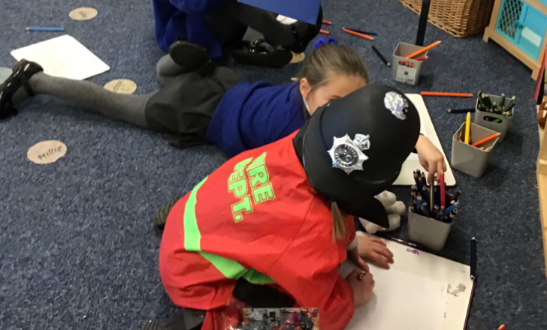
1. Communication and Language
Communication and Language development encourages children to build their speaking and listening skills. They learn how to express their ideas clearly, follow instructions, and understand new vocabulary. Through stories, songs, and conversations, children expand their language and communication skills, which are crucial for their success in all other areas of learning.

Slide 11
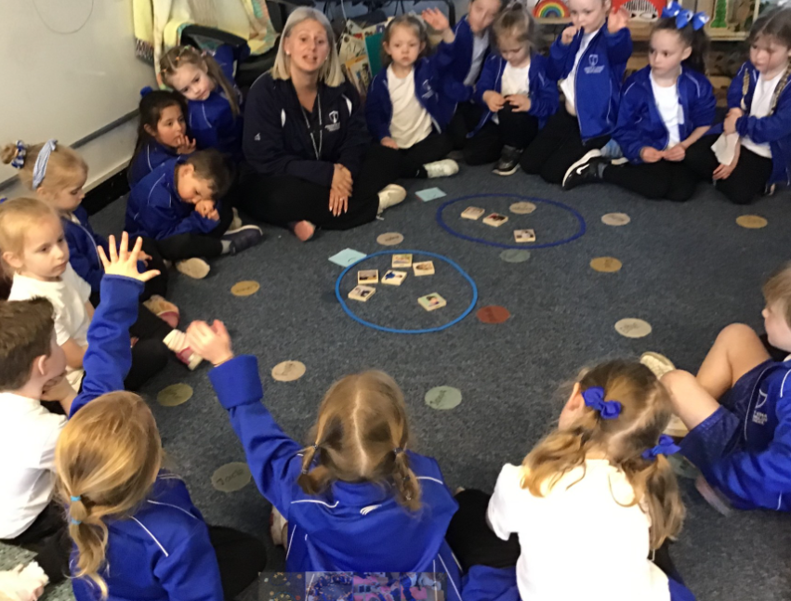
2. Personal, Social, and Emotional Development (PSED)
This area focuses on helping children understand themselves and others. It encourages them to form positive relationships, develop self-confidence, and manage their emotions. Children learn to express their feelings, share, take turns, and work with others. This area is fundamental as it helps children feel secure and ready to engage with other learning.

Slide 12
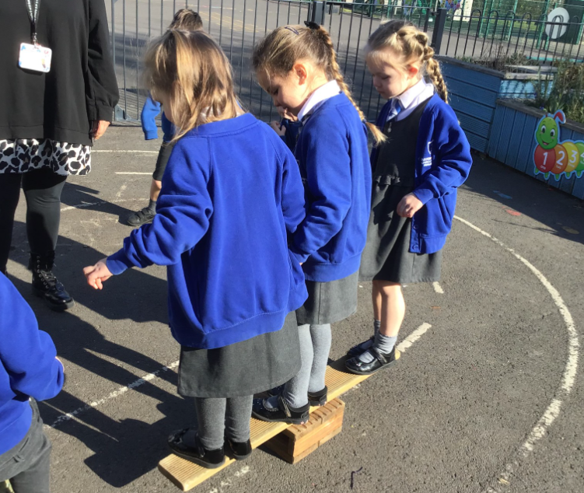
3. Physical Development
In this area, children develop both their fine and gross motor skills. Fine motor skills involve small movements such as holding a pencil or using scissors, while gross motor skills include larger movements like running, jumping, and climbing. Physical development is essential for overall health and well-being, as it helps children develop coordination, balance, and confidence in their abilities.

Slide 13

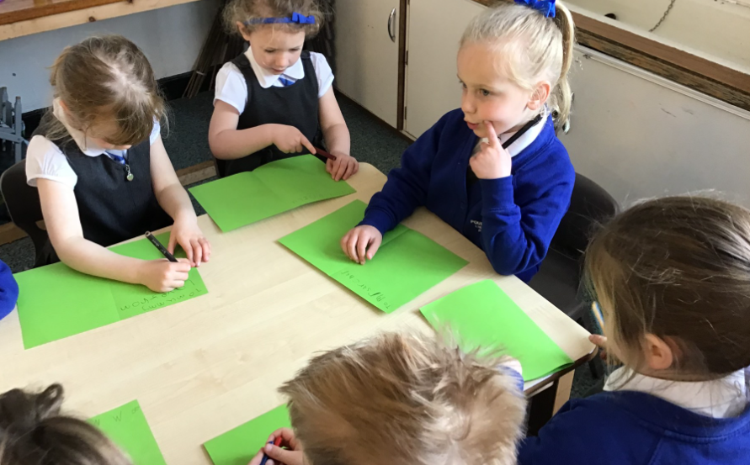
4. Literacy
Literacy focuses on developing children's reading and writing skills. In reception, children start to recognize letters and sounds, begin to blend sounds together to form words, and explore books and stories. They also begin to write, from drawing pictures to forming letters and simple words. Early literacy skills are foundational to later reading and writing success.

Slide 14

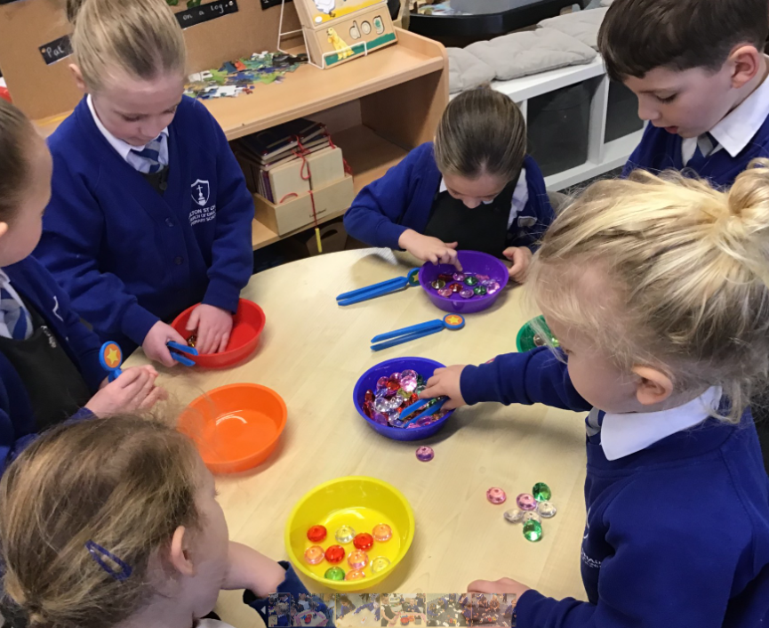
5. Mathematics
Mathematics in the EYFS involves helping children understand numbers, shapes, space, and measure. Children develop a sense of number through activities such as counting, recognizing numerals, comparing quantities, and solving simple problems. They also explore shapes, patterns, and basic concepts of time and money. This area fosters a child’s ability to think logically and solve problems.

Slide 15
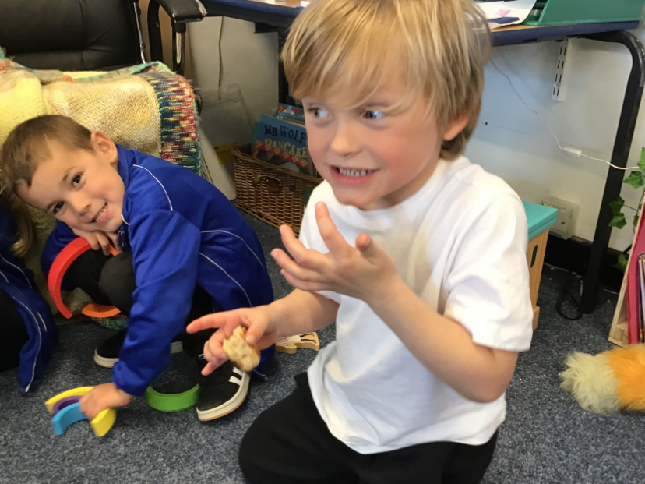
6. Understanding the World
This area encourages curiosity and exploration. Children learn about the world around them, including nature, different cultures, and the environment. They explore concepts such as time, seasons, and living things, and begin to understand how technology works in their everyday lives. Understanding the World helps children make sense of the world and develop critical thinking skills.

Slide 16

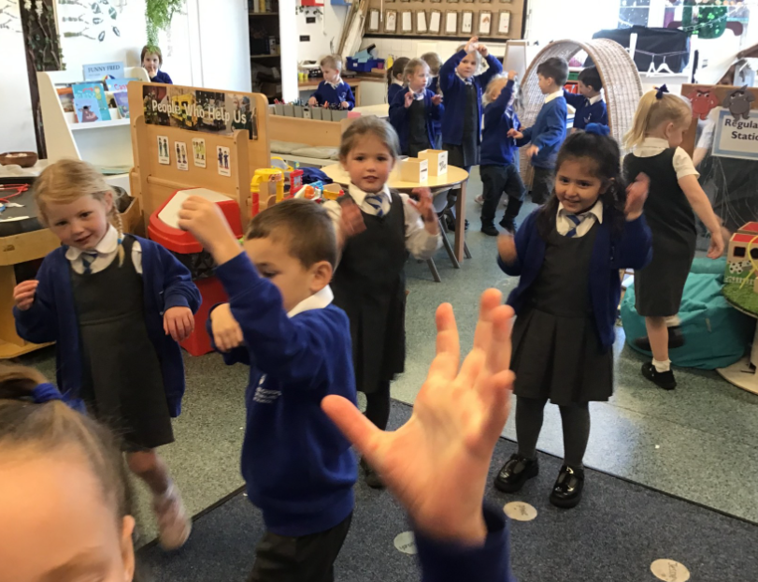
7. Expressive Arts and Design
Expressive Arts and Design allows children to explore their creativity through art, music, movement, and role play. They use their imagination to create stories, songs, and art, experimenting with different materials and techniques. This area helps children express their feelings and ideas and develops their confidence and creativity.

Slide 17
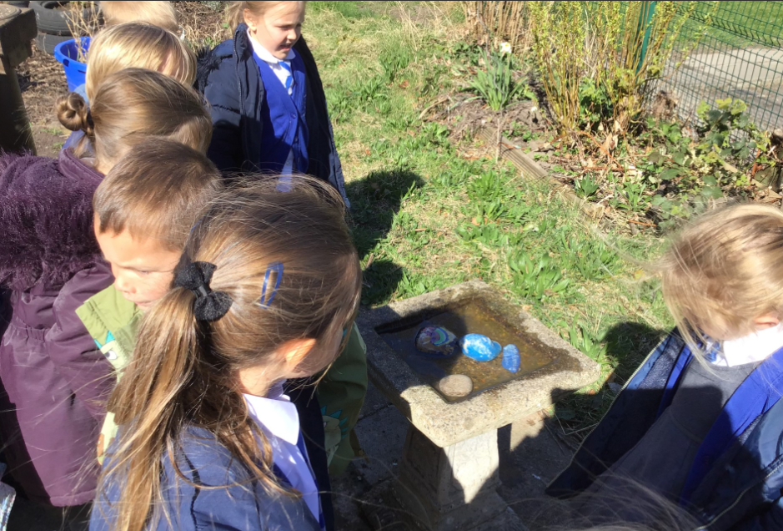
These seven areas of learning are interconnected and help children to grow as confident, capable, and independent learners. In Reception, the curriculum is designed to be flexible encouraging exploration and discovery, with plenty of opportunities for play, which is an essential part of the learning process. Each of these areas helps lay a solid foundation for the child’s future learning and development in school and beyond

Slide 18

What did Ofsted say?
A warm, purposeful and nurturing early years environment encourages children to settle quickly and confidently. The curriculum is well designed and carefully organised. Staff’s teaching and purposeful interactions ensure children get many opportunities to develop their communication and language skills. They do this through modelling and the use of imaginative play. For example, inspectors saw staff confidently guide children to make decisions and work cooperatively with their friends to build a monster truck. Indoor and outdoor activities offer abundant opportunities to support children's development in areas such as early mathematics, reading, writing and physical development.
Staff use their knowledge of early reading effectively. Children delight in sharing picture books with staff and with their friends. Many learn letters and their sounds with ease. They do this through well-crafted activities.
Staff have positive relationships with Reception class parents and carers. This enables them to build a secure understanding of children’s starting points. When needed, staff adapt provision thoughtfully, particularly for those children with special educational needs and/or disabilities or those who are disadvantaged.
Staff prioritise children’s personal, social and emotional development which ensures that children feel safe, secure and happy. As a result, children thrive socially, emotionally and academically and are well prepared for Year 1.

Slide 19

Poulton St Chads Church of England Primary School End of Reception expectations:
Read simple texts and stories with accuracy and comprehension.
Recognise and read all phonics sounds and tricky words up to level 3 and some level 4.
Write their own name correctly.
Form most lowercase letters with correct orientation; begin to form most capital letters accurately.
Write simple sentences using phonetic spelling, beginning to use capital letters, and full stops, written on a line.
Retell a familiar story using a story map.
Begin to read and self-check their work for accuracy.
Recognise and write numbers up to 10.
Count objects reliably up to 20.
Recall number bonds to 5 fluently.
Recall some number bonds to 10.
Name and draw basic 2D shapes: circle, square, triangle.
Hold a pencil using a correct grip.
Cut along a straight-line using scissors.
Dress and undress independently, including taking off and putting on jumpers.
Fasten their own coat.
Put on their own shoes.
Use a knife and fork to cut and eat food.
Use the toilet independently and wash hands afterwards.
Manage and take responsibility for their own belongings.
Change for school or PE independently.
Listen attentively and follow instructions.
Play cooperatively with others.
Take turns in games and group activities.
Understand and respect boundaries (e.g., when someone says "no").
Sit calmly on the carpet for up to 5 minutes.
Focus and engage in tabletop activities for up to 10 minutes.
Line up and move around school quietly.
Recite the Lord’s Prayer.
Sit respectfully and participate during whole school worship.
Draw a recognisable human face with basic features.
Know and say their full home address.

Slide 20

Parent Expectations
To support your child’s progress and well-being, we kindly ask that parents and carers:
Work in partnership with the school so we can provide your child with the best possible start to their educational journey.
Use email as the first point of contact for any queries, concerns, or issues. Please contact the class teacher directly before escalating to other staff members. Remember it is school policy that a reply will be sent within 48 hours.
Read with your child at least three times per week and record each reading session in their reading diary.
Sign the reading diary at least three times per week to show that regular home reading is taking place.

Slide 21
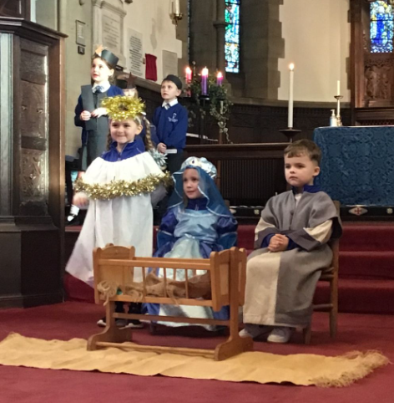
Working in Partnership with Parents
At Poulton St. Chad’s, we believe that a strong partnership between home and school has a positive impact on children's development, wellbeing, and learning.
We encourage parents to share information about their child's development, achievements, and any concerns they may have, helping us to provide the best possible support.
Parents can arrange to speak with their child's teacher by:
  Contacting the teacher or teaching assistants at the start of the school day
  Phoning the school office
  Emailing via the class email address
Throughout the year, we keep parents informed about their child's progress and learning journey.
In the Summer Term, parents receive a written report summarising their child's achievements and progress across the year.
Families are invited to join us for special school events, including:
  Nativity performances
  Special worships and celebrations
  Other school community events (some may be recorded)
We warmly encourage parents to become involved in school life by joining the Friends of the School (PTA) and supporting events throughout the year.
Together, we can provide the very best start to your child's school journey.

Slide 22




The Creative Corner
Each week, seven children from EYFS, seven from Year 1, and seven from Year 2 are selected to take part in learning activities in The Creative Corner. This rotation ensures that all children have regular opportunities to engage in rich, theme-based exploration throughout the year.
The Creative Corner is a rich and engaging learning environment where children explore themed topics through a range of foundation subjects. Our approach is guided by the Characteristics of Effective Learning, which include: Playing and Exploring, Active Learning and Creative and Critical Thinking.
Each academic year, we cover two main topics — one with a Geography focus and the other with a History focus. This year, our learning journey will take us into the rainforest as we explore the rainforest followed by a deep dive into dinosaurs. PE lessons take place on Wednesdays and Fridays. Please ensure children come to school wearing their PE kits on these days.
Some aspects of our learning are child-initiated, meaning children's interests and ideas play a key role in shaping the curriculum. Their voices are highly valued in the classroom.

Slide 23
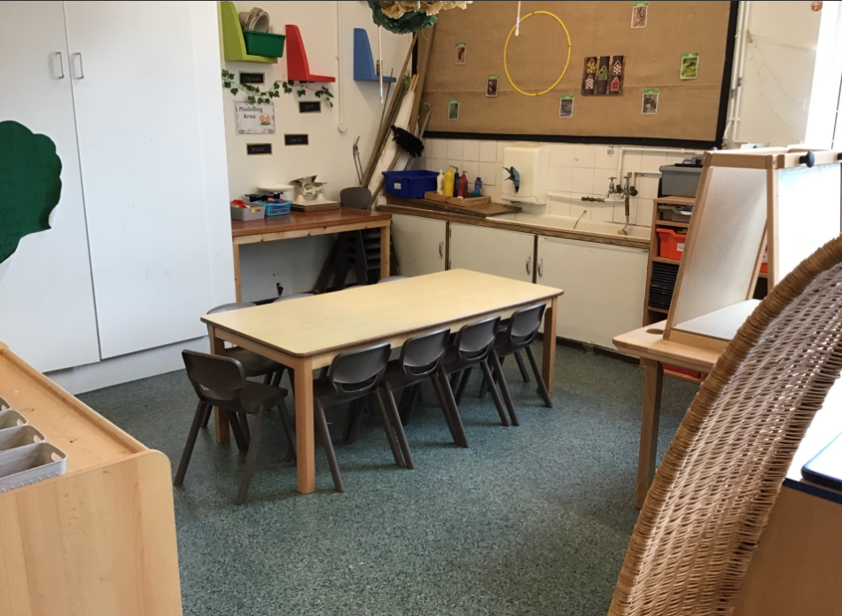
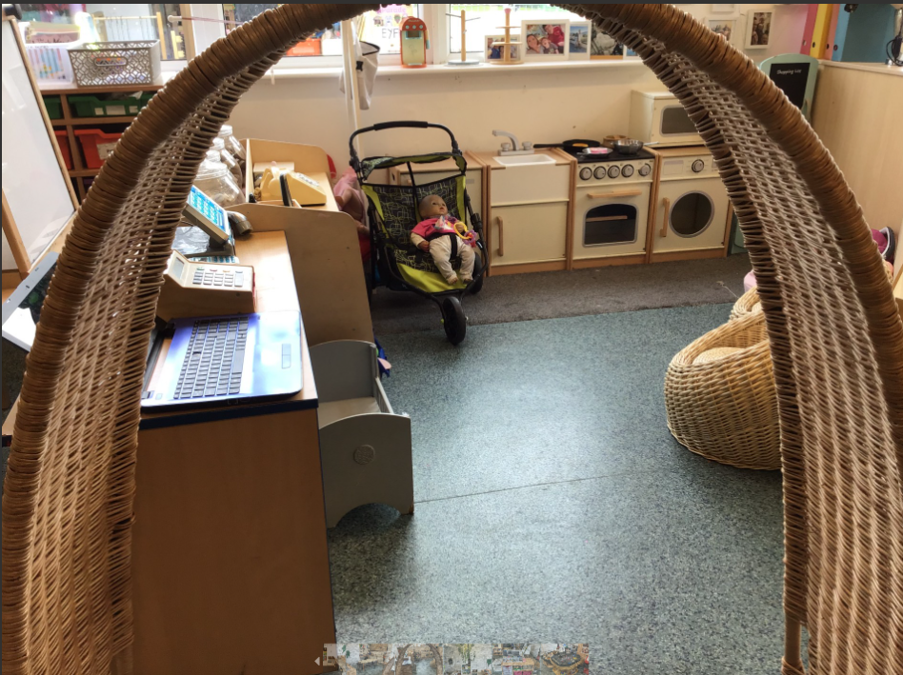
Classroom
Art and design area
Home corner

Slide 24
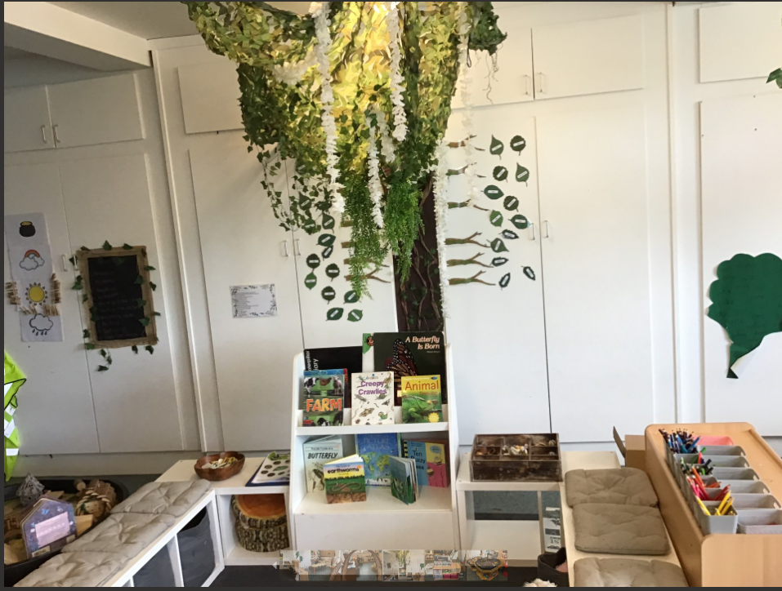
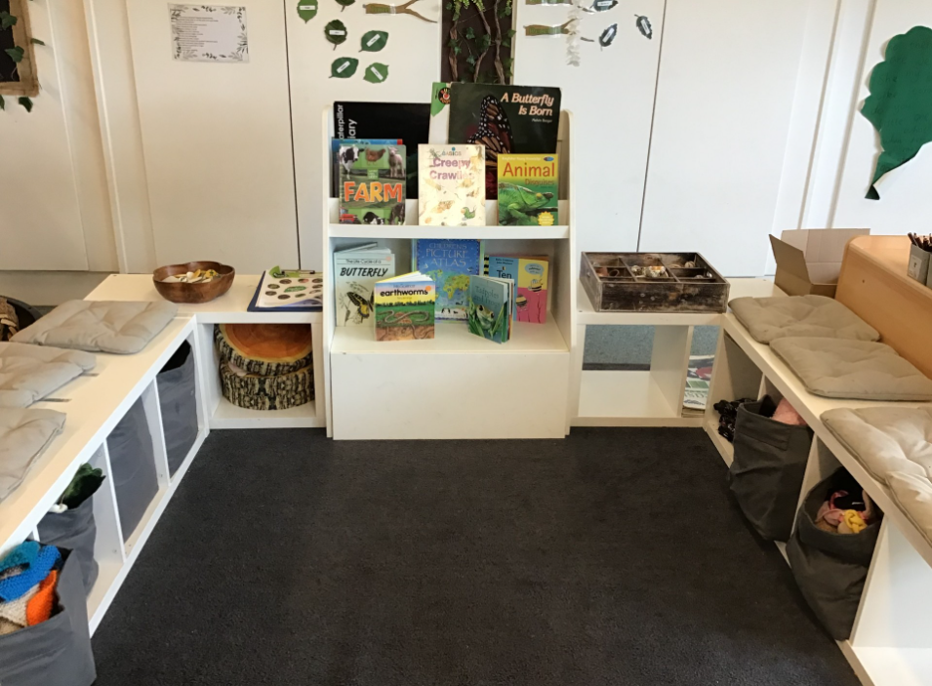
Reading Area

Slide 25
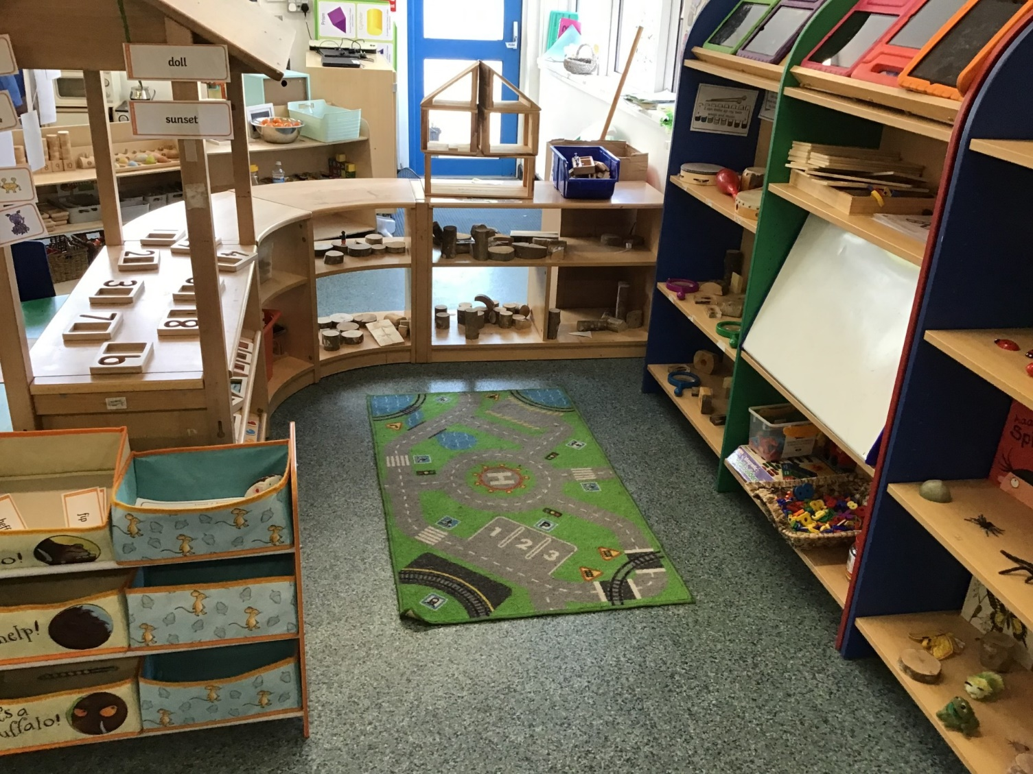
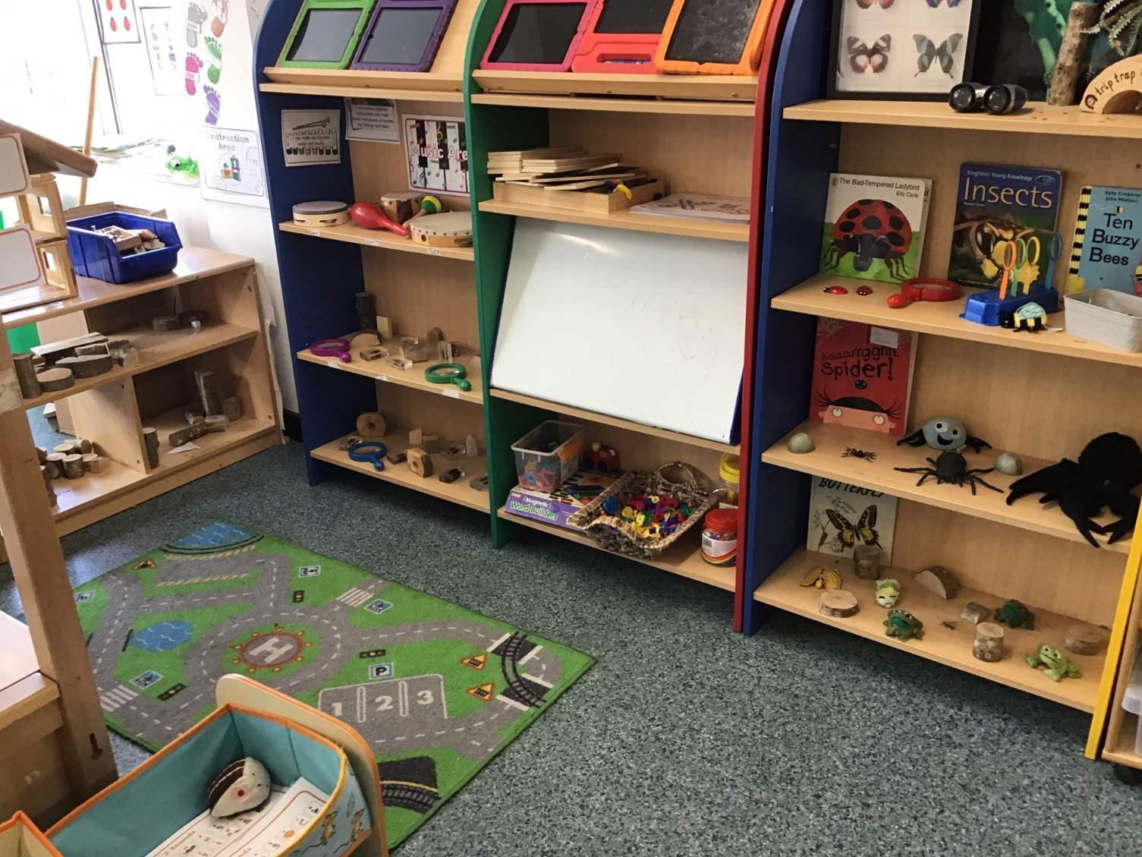
Small world and Construction Area

Slide 26
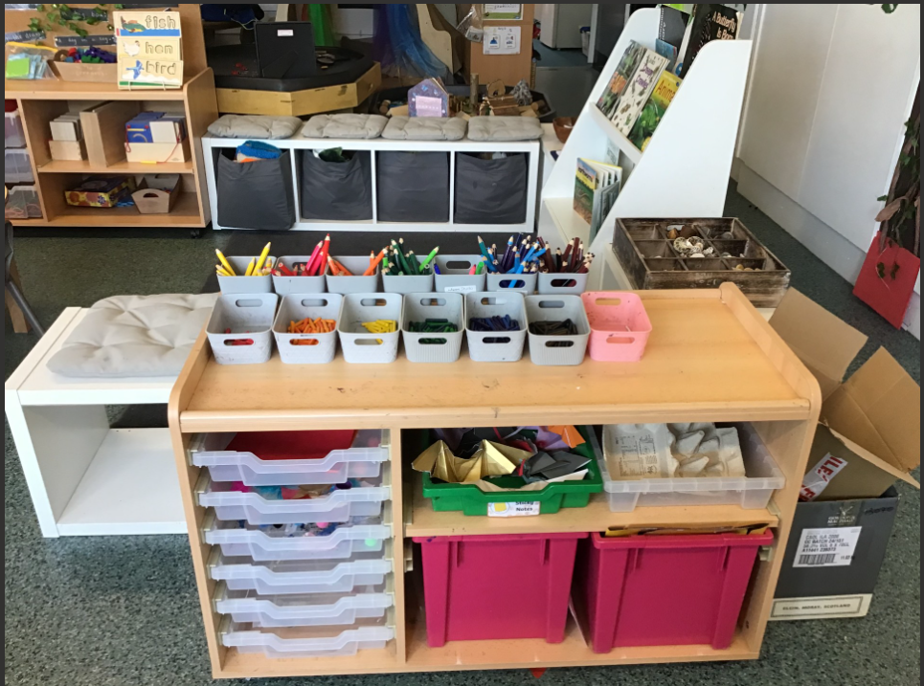
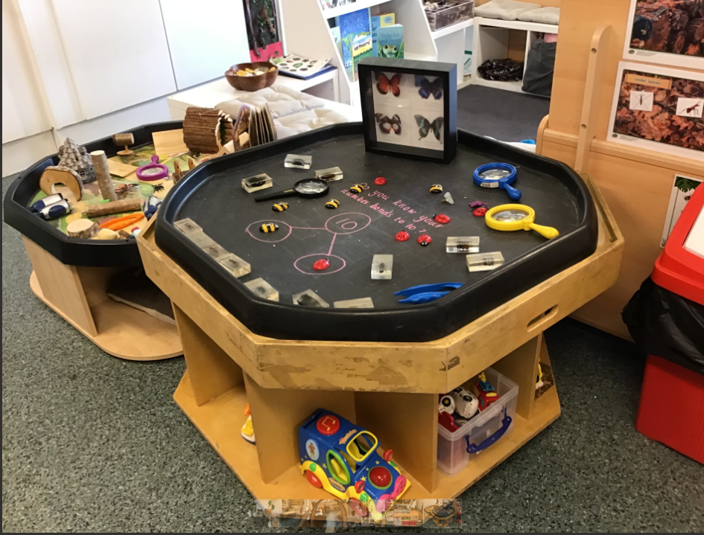
Art and crafts area
Continuous provision

Slide 27
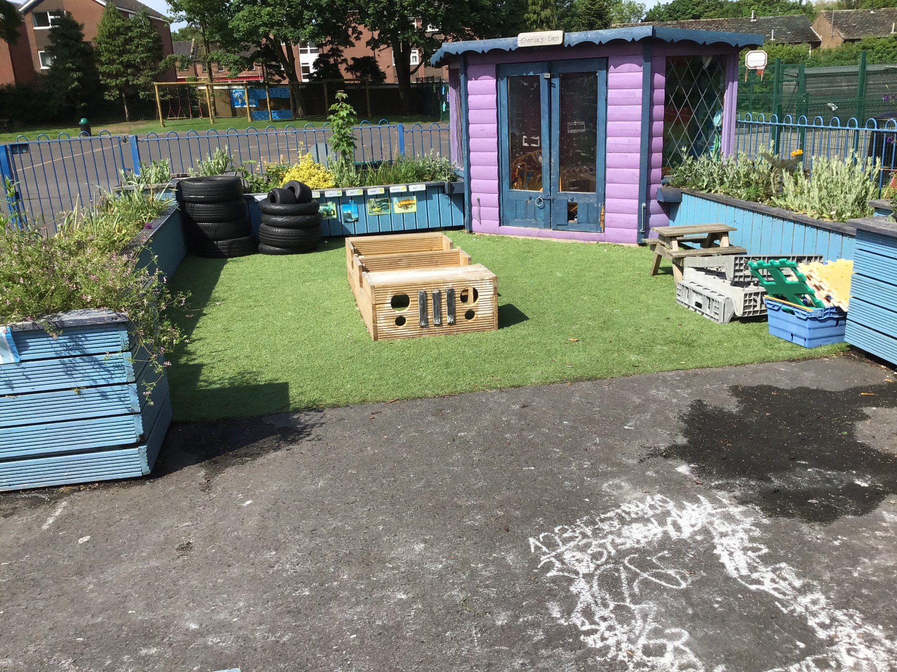
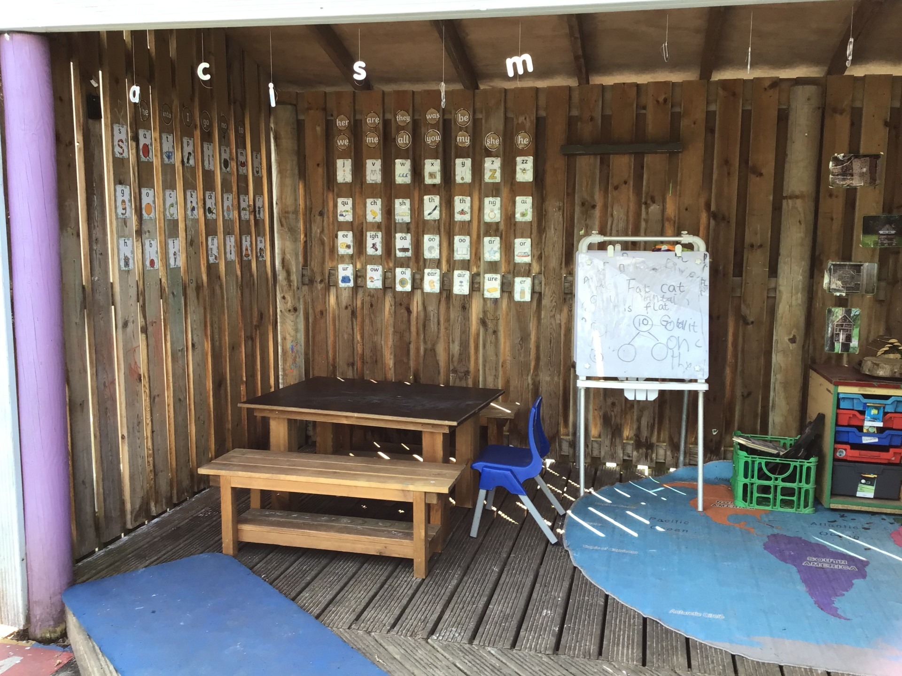
EYFS Outdoor Space

Slide 28
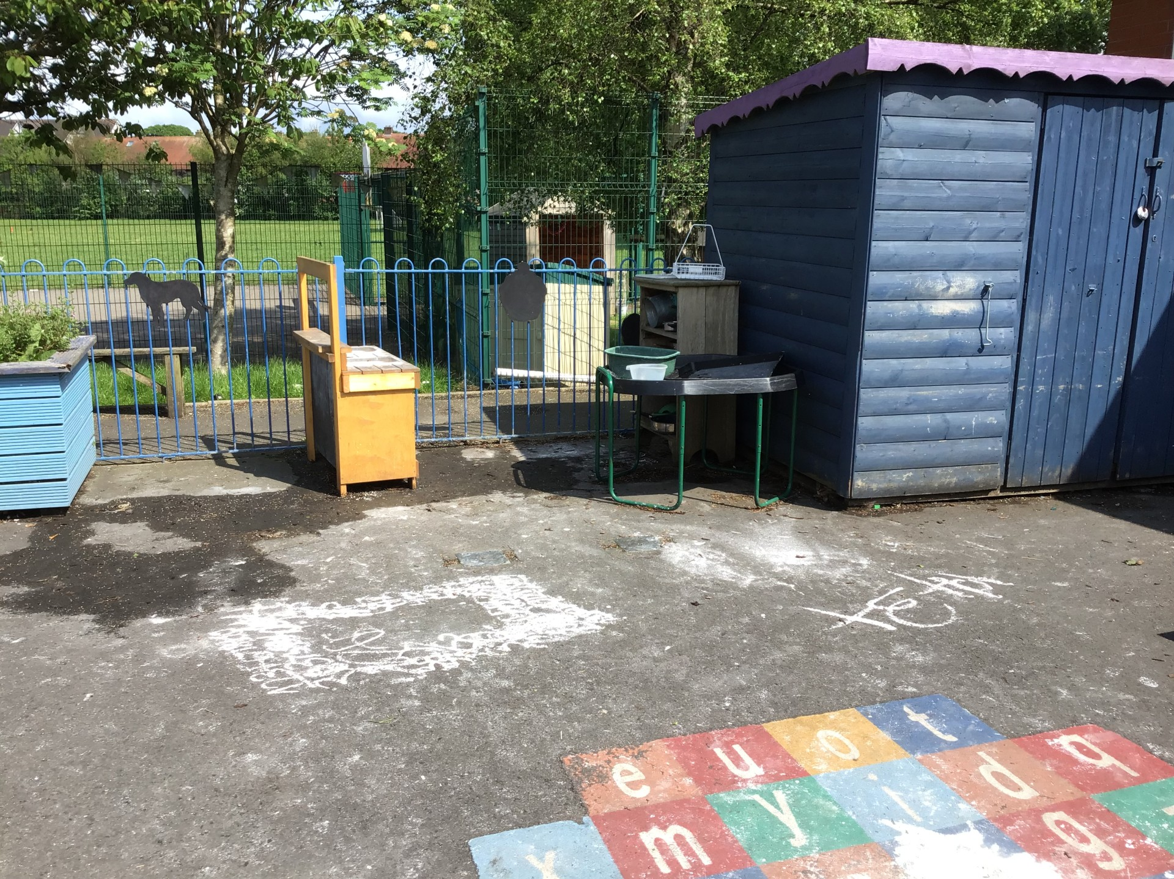

Slide 29
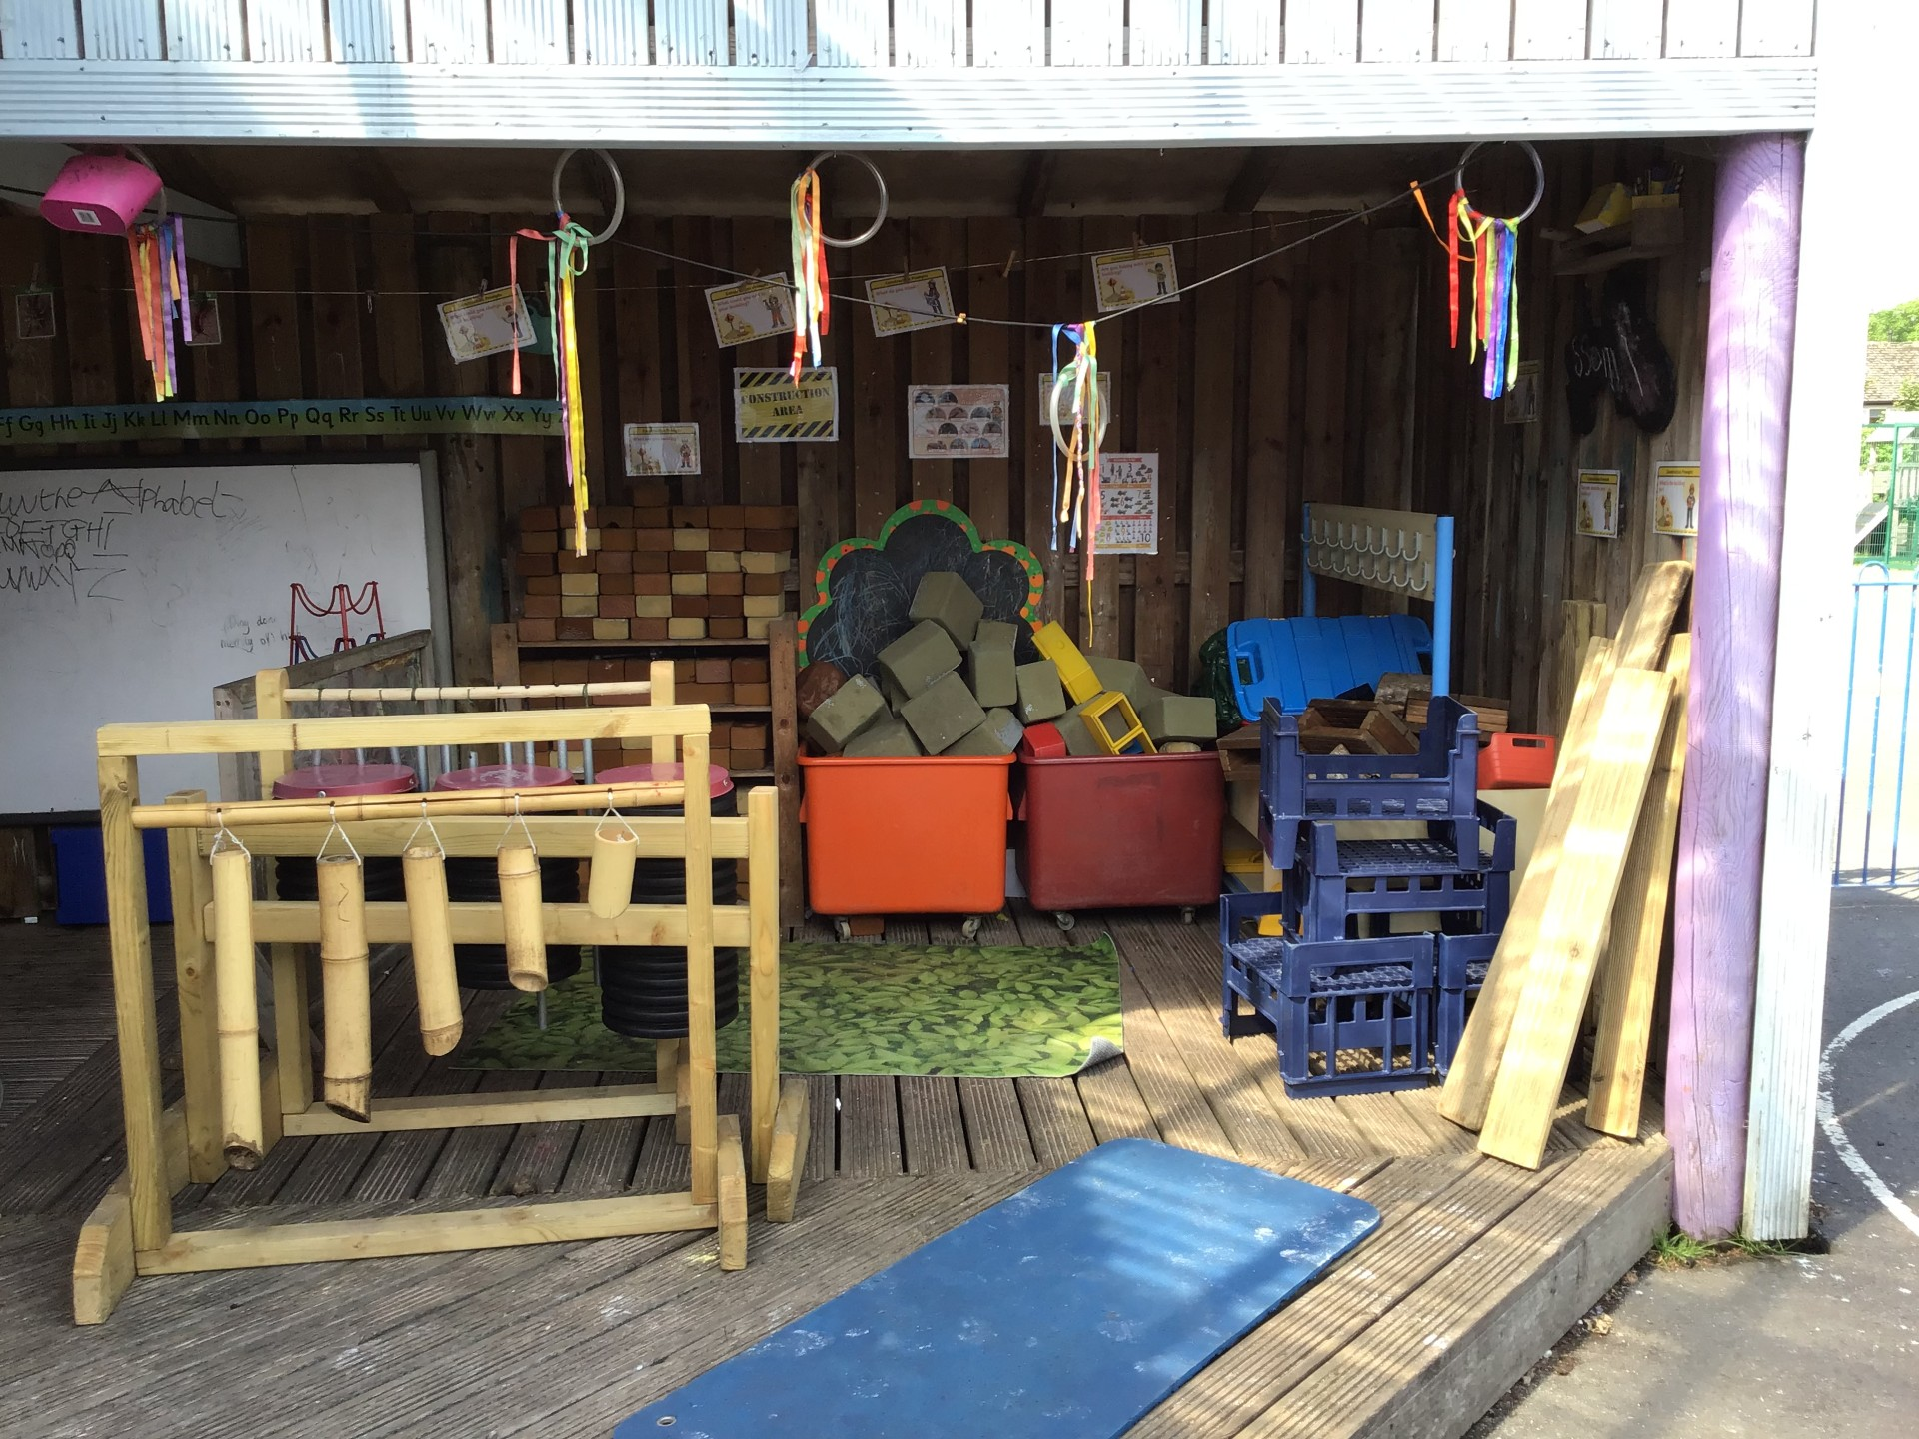
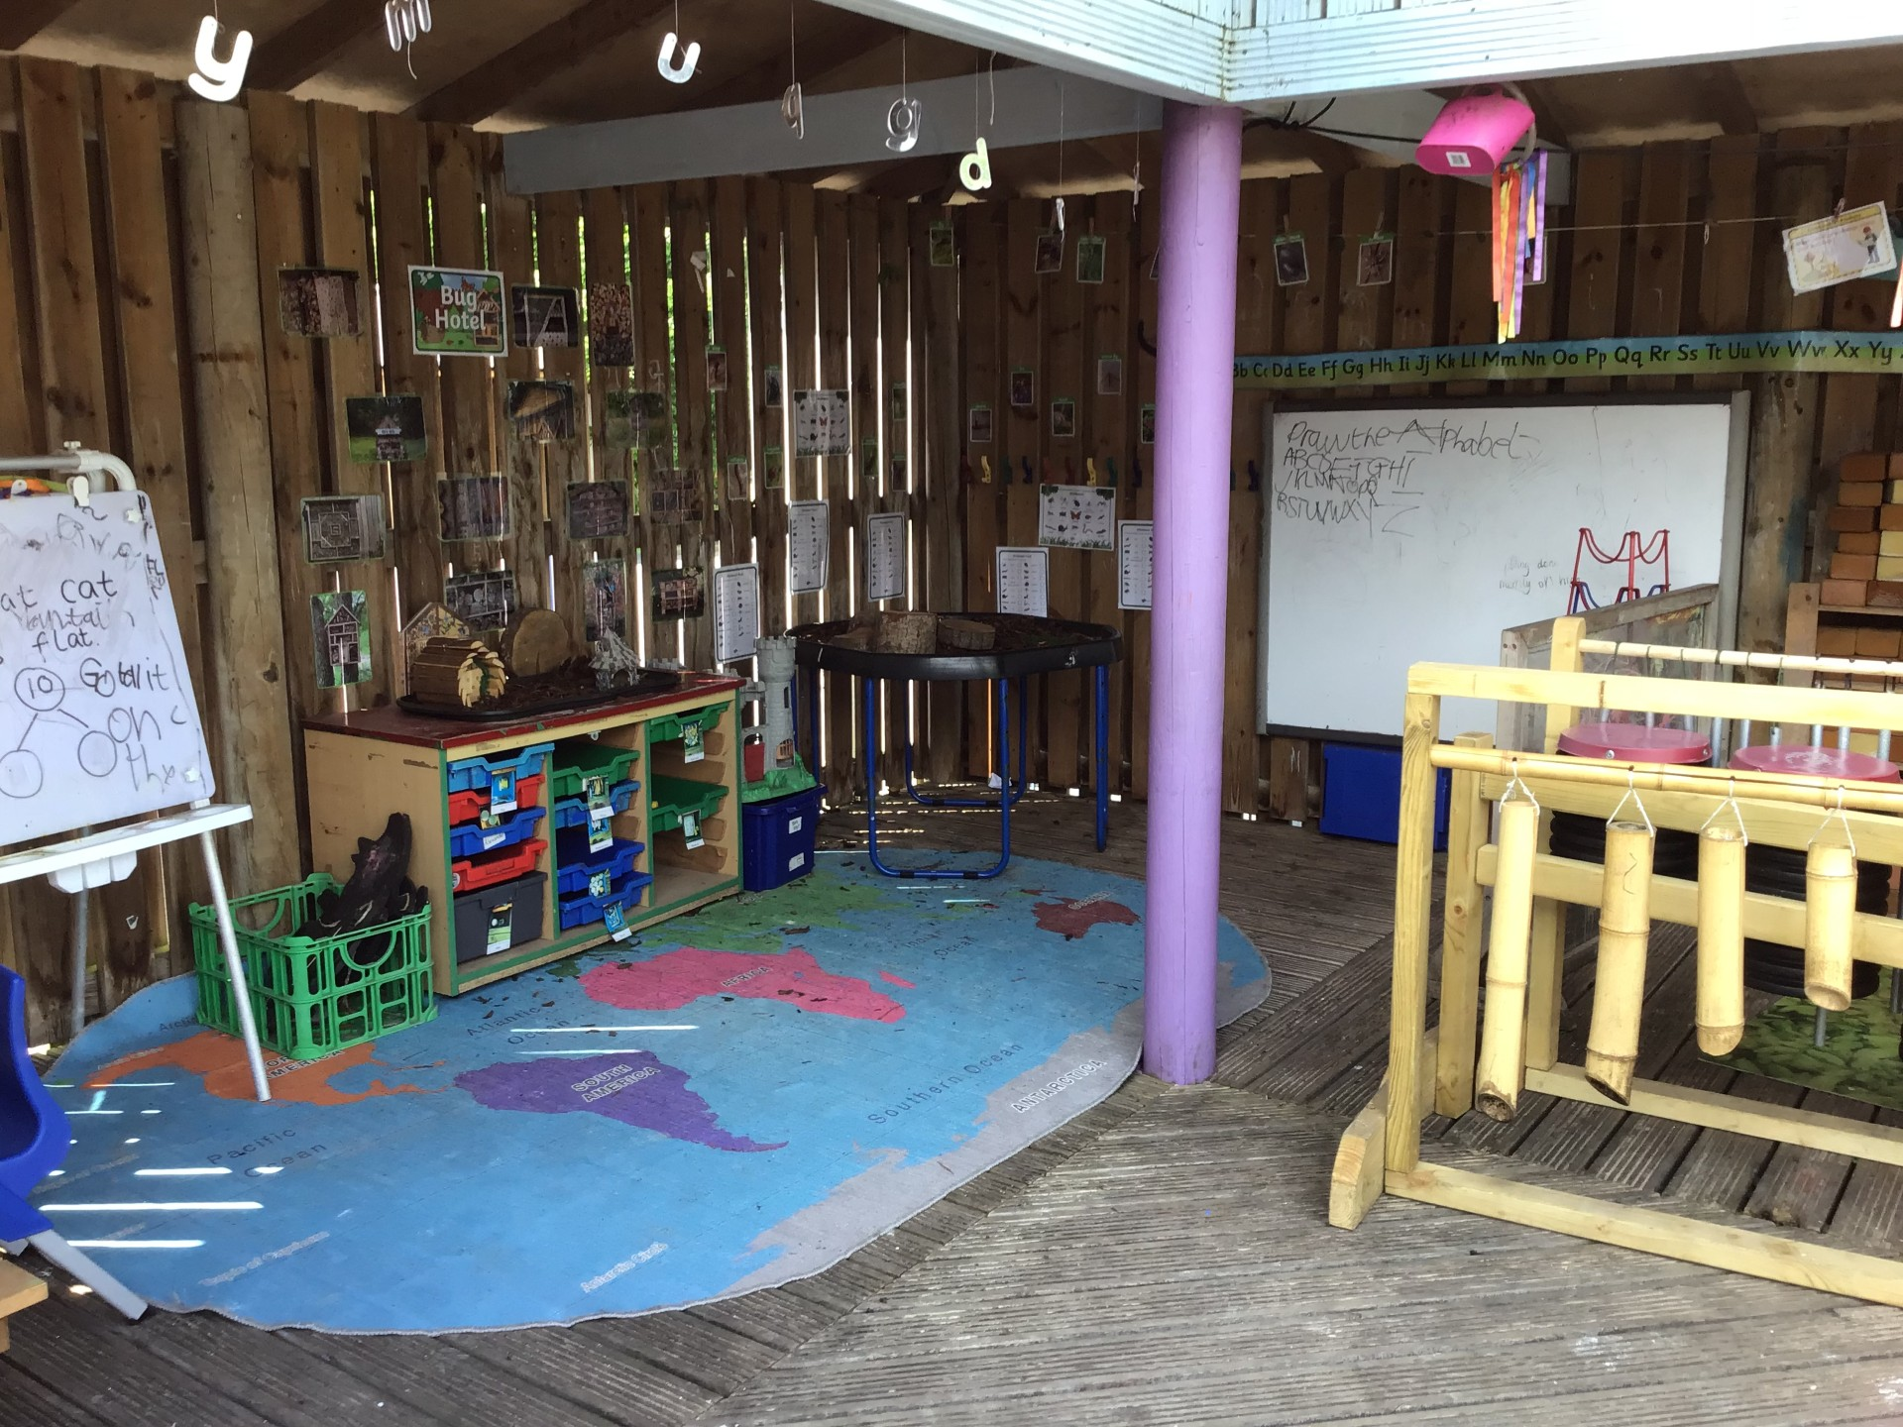

Slide 30
A day in the life of a reception child

Slide 31
Daily Timetable In the EYFS Classroom
8:45
Come into school
Register
phonics
literacy
10:45
Break
Maths
Literacy
12:00
Lunch
Topic
3:10
Home time

Slide 32
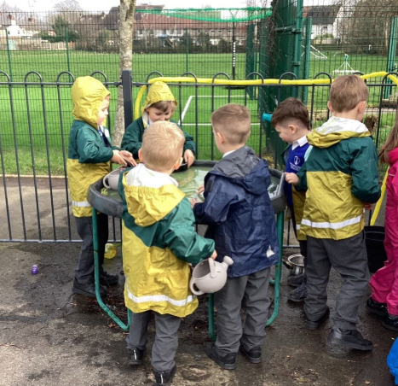
What Will My Child Need in EYFS?
To help your child have a happy and successful start at school, please ensure they bring the following:
Every Day
🎒 A named school book bag
💧 A named water bottle containing water only
🧥 A named coat suitable for the weather and wellies
😊 A smile and a positive attitude ready for learning!
PE Days
👟 A named PE kit, including suitable footwear (black velcro trainers)
Outdoor Learning
🌦️ We learn outdoors in all weathers, so please ensure your child has appropriate clothing for the season:
Warm coat, hat and gloves in winter
Sun hat and sun cream applied before school in warmer weather
Please Remember
🏷️ Label all clothing, shoes, bags and belongings clearly with your child's name, Friends have provided you all with some labels with your children’s names in your starter packs.
👕 Encourage your child to practise putting on their coat, fastening zips and changing independently.
Together we can help your child make a confident and happy start to school! 🌟

Slide 33


Parent Communication
In the EYFS we use Seesaw as a way to show you what your child has been learning each week. On a Friday all the pictures from the week are uploaded with a write up of what your child has been doing throughout the week. We also use Seesaw as a way of messaging parents and guardians to inform you of any upcoming events. As a school we use parent apps also as a way of contacting parents and relaying important information such as events happening within school. A log in will be provided once your child has begun school.

Slide 34

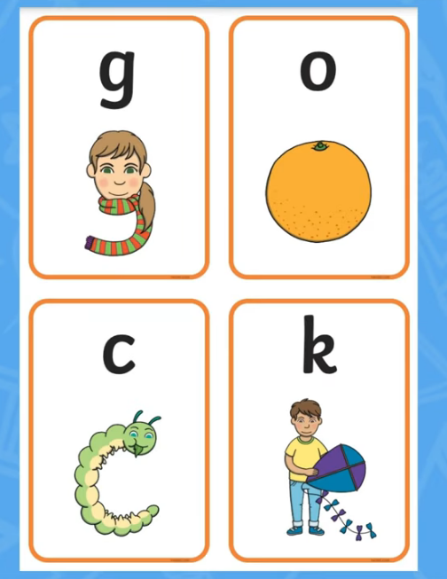
Twinkl Phonics Level 2 Sounds and Actions (youtube.com)
Twinkl Phonics Level 3 Actions and Sounds (youtube.com)
We use the Twinkl Phonics scheme throughout school to help your children learn new sounds and how to read. Here are two links to the sounds and actions we use so you can help at home.

Slide 35
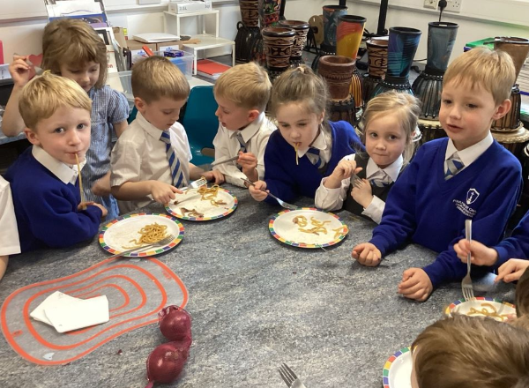
Snack Time & Lunchtime in EYFS
🍎 Healthy Snack Time
• All children receive a free piece of fruit each day through the National School Fruit Scheme.
• Children are encouraged to try the fruit, but are not required to eat it.
• If you choose to provide a snack from home, please send only one healthy snack, such as:
Fruit
Raisins or dried fruit
Breadsticks
Plain biscuits
🚫 Please do not send chocolate, sweets, crisps or nuts. We are a nut-free school and promote healthy eating.
🍇 For safety, please ensure grapes are cut in half.
🥛 Milk & Water
• Free milk is available for all children until they turn five.
• After their fifth birthday, milk can still be provided through a paid scheme.
• Children may also drink water throughout the day.
💧 Please send a clearly named water bottle filled with water only.
🚫 No fruit juice or flavoured water, please.
🍽️ Lunchtime
• Reception children eat in the hall before the older children, providing a calmer environment.
• School meals are freshly prepared on site and follow Healthy Eating guidelines.
• Children choose from three meal options each morning.
• All children in Reception are entitled to Universal Free School Meals.
🌟 Developing Independence
• We encourage good manners, including saying "please" and "thank you".
• Children are supported to use cutlery independently and we appreciate your support in practising these skills at home.
🛡️ Safe Eating in EYFS
• We follow EYFS safer eating practices at all times.
• Staff supervise children carefully during snack and lunch times.
• Children are taught how to sit safely, chew carefully and eat at an appropriate pace.
• Food is prepared and served with children's safety and wellbeing as our priority.
Our aim is to make snack and lunchtime a happy, healthy and safe part of every school day.

Slide 36
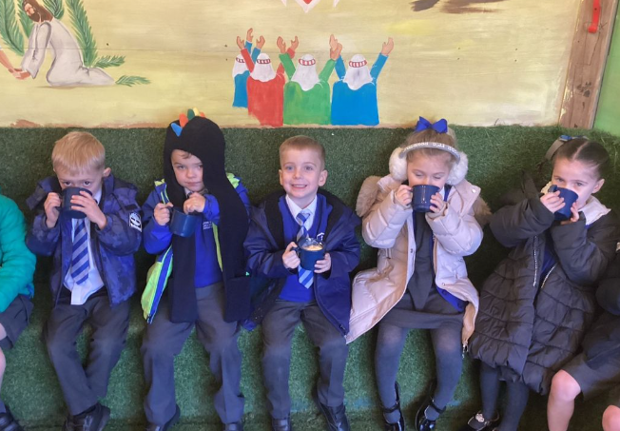
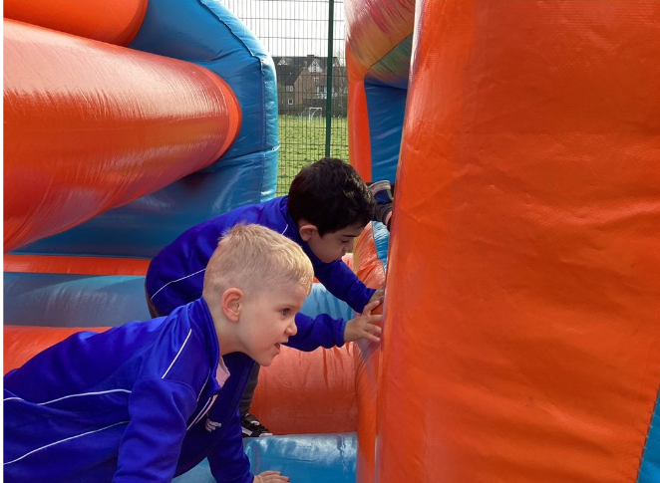
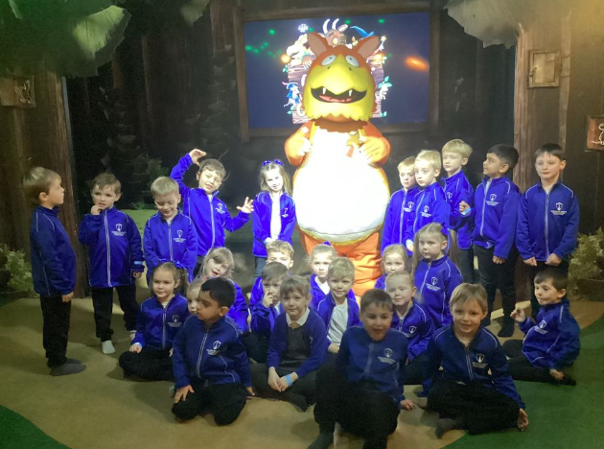
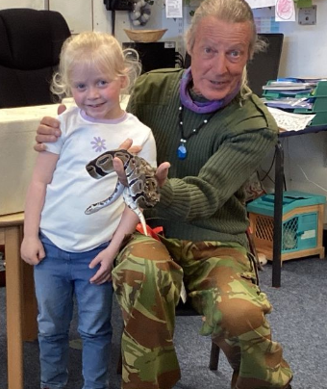
EYFS Enrichment & Extra-Curricular Activities
At Poulton St Chad's, we believe that learning extends beyond the classroom. We provide a range of exciting experiences that enrich children's learning, develop new skills and create lasting memories.
Enrichment Opportunities
🌟 Trip to the Gruffalo Club House to support our learning about fairy tales and storytelling
🐞 Visit from the Mini Beast Roadshow, giving children hands-on experiences with a variety of fascinating creatures
🎈 Inflatable Day – a fun-filled day of physical activity and enjoyment
🍦 Ice Pops in the Garden during warmer weather and ☕ Hot Chocolate in the Garden during colder months, helping us celebrate achievements and enjoy time together outdoors
Extra-Curricular Activities
⚽ Multi-Skills Club to develop coordination, teamwork and confidence
🧘 Yoga Club to promote wellbeing, balance and mindfulness
🎨 A variety of additional clubs and activities are offered throughout the year
Our Aim
To provide rich, memorable experiences that inspire curiosity, build confidence and foster a love of learning.
"Creating happy memories while developing confident, curious learners." 🌟

Slide 37
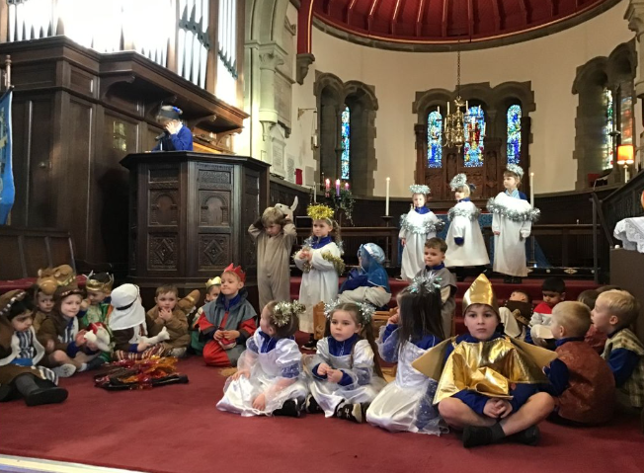
Collective Worship at Poulton St Chad's
As a Church of England school, Collective Worship is an important part of our daily life and helps us to grow together as a caring Christian community.
Daily Prayers
• In the morning during worship begin our day together
• Before lunch to give thanks for our food
• At the end of the day to reflect and give thanks
Daily Worship
• Children take part in Collective Worship every day.
• Worship may be held as a whole school, in key stages, or within individual classes.
• We explore Christian values, Bible stories, prayer, reflection and important world events.
• Children are encouraged to think deeply, ask questions and reflect on their own beliefs and experiences.
Working with Our Church
• We are fortunate to have a strong partnership with St Chad's Church.
• Reverend Keighley visits school each week to lead Collective Worship with the children.
• These sessions help children to deepen their understanding of Christian faith and values in an engaging and meaningful way.
We regularly visit St Chad's Church throughout the year for special services and celebrations, helping children strengthen their connection with our church community.
Our Aim
Through Collective Worship, we encourage children to develop kindness, respect, compassion and a sense of belonging within our school family.

Slide 38
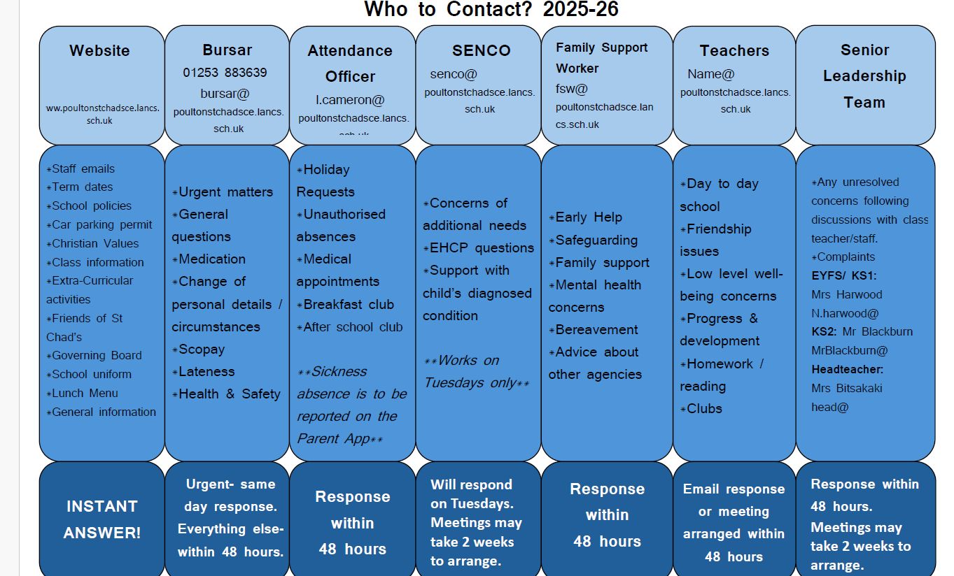

Slide 39
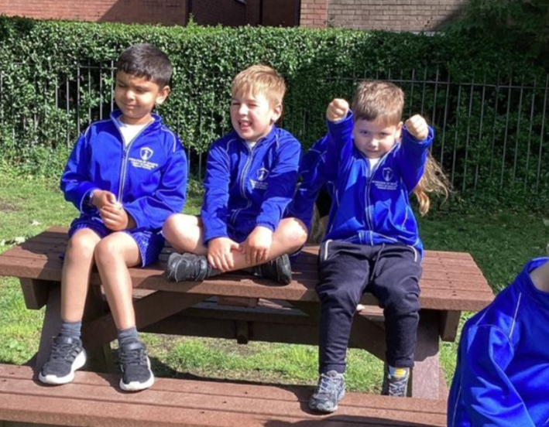
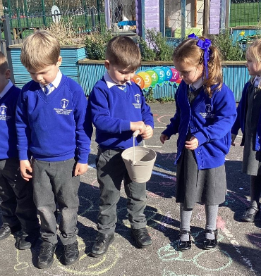
Uniform
Uniform is stocked by Bispham Clothing (7 All Hallows Rd, Blackpool FY2 0AS, Phone: 01253 353701).
Please ensure all items are named on the inside, you will find some name labels in your starter packs that friends have provided for you.
Having names or initials emblazoned on the outside of your child’s clothing is not allowed- this can be a safeguarding risk.
Children in EYFS, Year 1 and Year 2 are asked to have a book bag for school as we do not have enough space for large rucksacks.
Hair styles
Long hair needs to be tied back. Hair ribbons/bobbles/headbands etc should be school colours or neutral (black/brown) and not sparkly or over-sized. Coloured hair braids/beads and hair gel are not allowed. There should be no extreme hair styles, such as dyed hair, braids, fashion cuts, shaved heads or patterns shaved into hair.

Slide 40
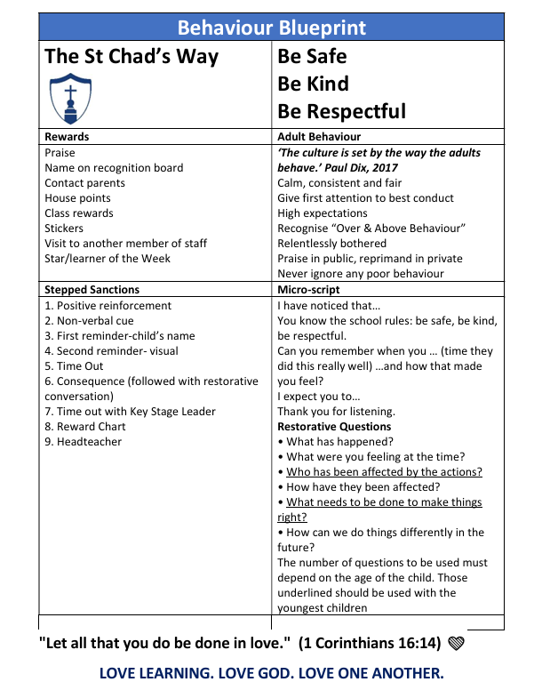
Behaviour at St Chad’s
Our Aim
We want every child to feel happy, safe, included and valued.
We help children learn how to make positive choices and build strong friendships.
We work together with families to encourage kindness, respect and confidence.
Our Three Golden Rules
⭐ Be Safe
⭐ Be Kind
⭐ Be Respectful
How We Celebrate Positive Behaviour
Praise and encouragement
House points and certificates
Stickers and recognition
Special responsibilities
Positive messages home
When Children Make Wrong Choices
We use mistakes as opportunities to learn.
Staff help children understand their choices and repair relationships.
Consequences may include a reminder, time to reflect, or loss of a privilege.
We always use a calm, fair and consistent approach.
Our Goal: To help every child develop the skills to make good choices, show kindness, and enjoy being part of our school community. 🌟

Slide 41
Special Educational Needs and Disabilities (SEND)
At Poulton St Chad's, we are committed to ensuring that every child feels valued, included and supported to achieve their full potential.
How We Support Children
• High-quality teaching that meets the needs of all learners
• Early identification of additional needs and close monitoring of progress
• Individual support and targeted interventions where appropriate
• Support for communication, social, emotional and sensory needs
• Strong partnerships with parents and external agencies
Working Together
We believe that parents are key partners in their child's learning journey. We encourage open communication and will always work closely with families to ensure the best outcomes for every child.
Need to Talk?
If you have any concerns about your child's development, learning or wellbeing, please speak to your child's class teacher. Our SENDCo is also available to offer advice and support.

Slide 42
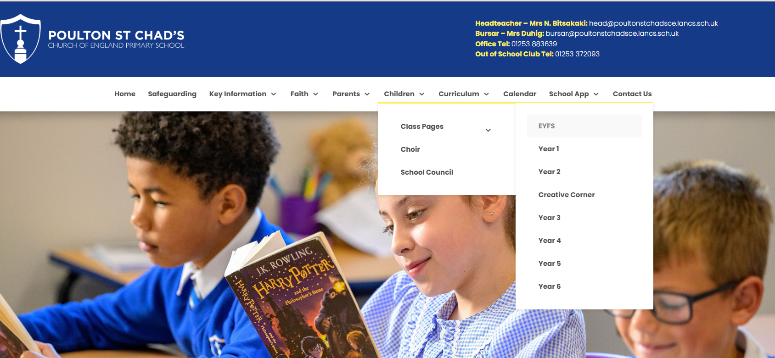
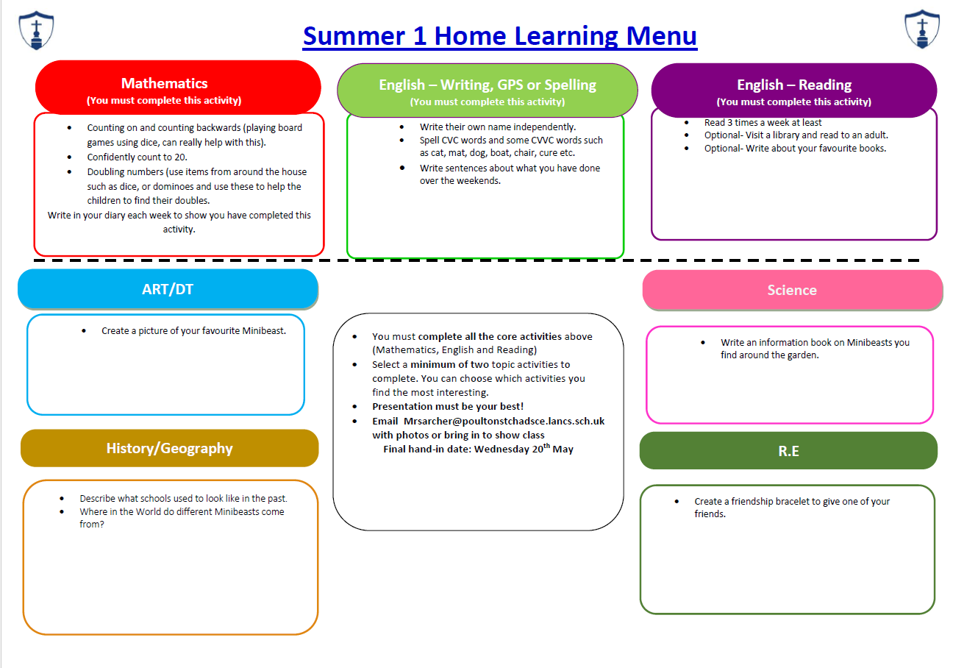
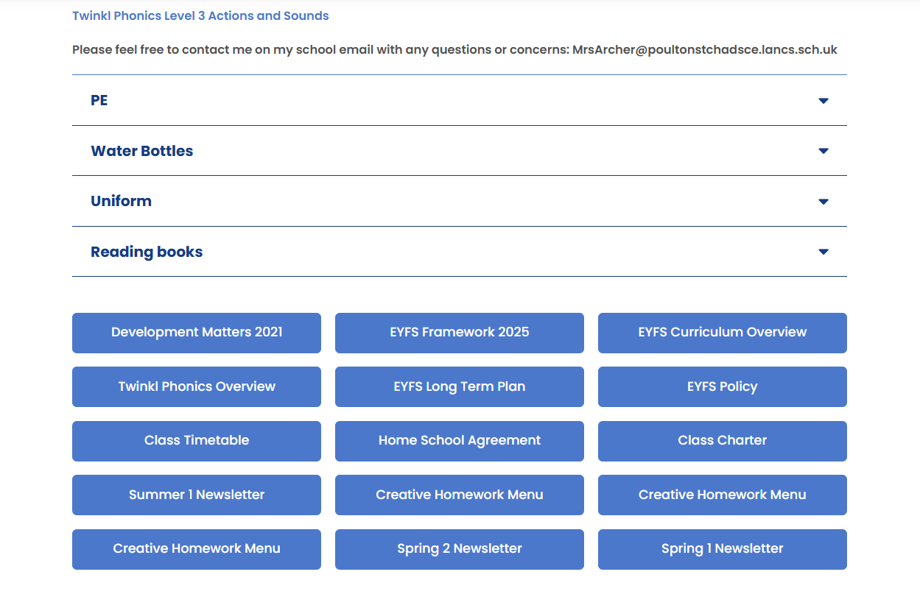
Any information you need can be found on our school website within our induction page and class page. All home learning menus and newsletters are posted on our class pages.

Slide 43
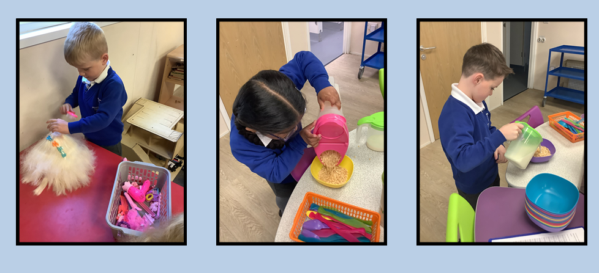
Out of School Club
Before and After School Care at Poulton St. Chad's
We understand that families may require childcare outside of the school day, and we are pleased to offer our Out of School Club to support working parents and carers.
What We Offer
A safe, caring, and welcoming environment for children.
Before and after school childcare for pupils attending Poulton St. Chad's.
A range of engaging activities, including:
  Arts and crafts
  Games and puzzles
  Outdoor play
  Reading and quiet activities
  Opportunities to socialise with friends
Benefits for Children
Familiar school surroundings and trusted staff.
A relaxed and enjoyable start or end to the school day.
Opportunities to develop independence, confidence, and friendships.
Booking and Further Information
Places can be booked through the school office.
Details of session times, availability and current charges are available from the school.
We recommend booking in advance where possible to secure a place.
Supporting Our Families
Our Out of School Club provides flexible childcare while ensuring children continue to feel happy, safe, and supported as part of the Poulton St. Chad's school community.

Slide 44
Useful Contacts
Teacher Email:
mrsarcher@poultonstchadsce.lancs.sch.uk
School Bursar:
bursar@poultonstchadsce.lancs.sch.uk
Family Support Worker:
fsw@poultonstchadsce.lancs.sch.uk
Attendance and Breakfast and Afterschool Club:
l.cameron@poultonstchadsce.lancs.sch.uk

