Slide 1

LOVE LEARNING. LOVE GOD. LOVE ONE ANOTHER.
“Let all that you do be done in love” (1 Corinthians 16:14)
At Poulton St Chad’s, we believe every child is a gift from God, blessed with their own gifts and talents. It is our mission to ensure children are safe, happy and can thrive. We aim to give our children a love for learning through our engaging curriculum and enrichment opportunities; a love for God within our distinctly Christian setting and a love for one another through our nurturing environment and inclusive relationships.

Slide 2

Welcome
“Would 100% recommend St Chads. They have been a great school for our family!” (Ofsted Parent View 2026)
Year 2
Miss Siddall

Slide 3

Practicalities
Please label all of your child’s uniform and their packed lunch box so it is easier to return if lost.
Your child should have a waterproof coat with a hood in school.
All children should have a named water bottle which contains only water.
KS1 are provided with free fruit. Milk is available to buy through Cool Milk.

Slide 4
Practicalities continued
If someone different is picking your child up, please phone the office in advance so that they can inform their class teacher.
School starts at 8.55am. The gate opens at 8:40am.
Please drop your child off at the outside door. If your child is late they must enter school via the office and a late form completed by an adult.
School finishes at 3.10 for EYFS- Year 3 and 3.15pm for Years 4-6 (at the request of parents).

Slide 5
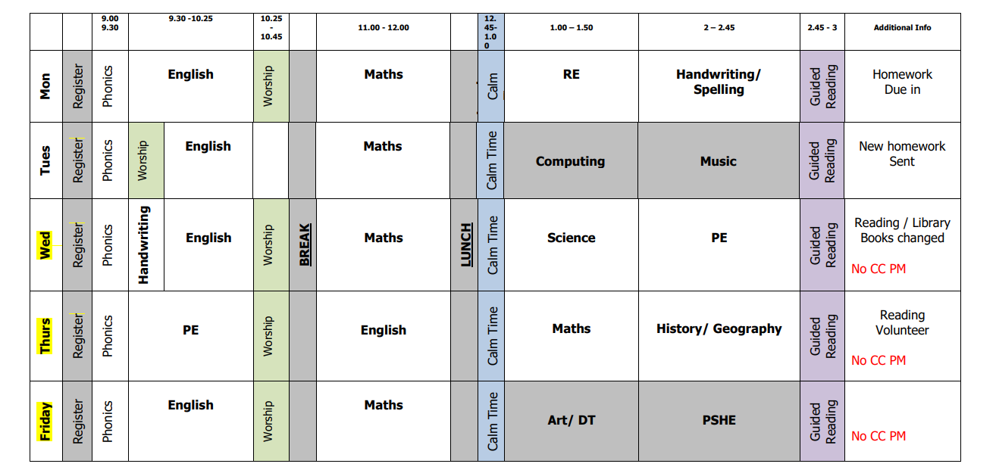

Daily Timetable

Slide 6
P.E.
In Year 2, your child will have P.E on Wednesdays and Thursdays. Please ensure that they come dressed in P.E kit on these days.
Please ensure children wear appropriate trainers. No laces, unless children can tie them independently.
Jewellery must not be worn for PE (earrings must be covered with plasters or taken out by the child)
Long hair must be tied back during school and all P.E lessons (only plain navy or blue hairbands are acceptable).

Slide 7
Behaviour
”pupils behave well and show great respect for one another” (OFSTED 2026)
We ask that parents support our Behaviour and Relationships policy, which is available on our website.
It is important that we work together as a partnership and that you understand how behaviour issues are dealt with at school.
At St Chad’s we promote positive behaviour throughout and we have many positive reinforcements in place. For example in Year 2, we reward with a recognition board, house points, stickers, secret star and Percy Parrot.
Children are also chosen for Star Of The Week and Learner Of the Week Awards. We have the Floki award and the Class of the Week award!
Our Head Boy and Girl and our Deputy Head Boy and Girl promote positive behaviour.
We always try to catch children being good!

Slide 8
Behaviour Continued
We now have regulation stations throughout school in case children need a few moments to try and regulate themselves.
If your child demonstrates poor behaviour in class, they will be given a warning. If their behaviour does not improve and they have moved through the different levels of the behaviour policy, then they will speak to their class teacher during ‘Quiet Time’ and parents will be contacted if this is repeated.
We ask parents to avoid trying to reverse a decision made in school as this can be very unhelpful for your child.
Please contact the class teacher if you have any concerns about your child’s behaviour.

Slide 9
Attendance- 98%
We have updated our attendance policy which is on the website- our target is now 98%. As part of our whole-school approach to achieving this target, we are introducing a termly attendance rewards programme.
Children who meet the agreed attendance criteria will receive a Bronze, Silver, or Gold Attendance Certificate each term
All children who achieve the relevant attendance threshold will be entered into a prize draw at the end of each term, giving them the opportunity to win a special reward.
There will also be a weekly attendance prize for the class with the highest attendance. We hope this initiative will encourage excellent attendance and celebrate the positive efforts of our pupils and families.
100% excellent | 98-99% meeting school target | 96-97% close to school target Phone call + letter | 90-95% below school target (cause for concern) Parent contract | Below 89% Persistent Absence- (SA= 50% and below)

Slide 10
Home Learning
  Here is your child ‘s Creative Home Learning Menu is now available on the school website. (PLEASE SHOW WEBPAGE)
  The termly Newsletter explaining what the children will be learning about in each subject is also on the Y2 page on the website.
  In Year 2, Homework is set on Tuesdays and due in the following Monday.
  We will have a ‘Come Discover with Me’ session in September for each class. – Monday 28th September, 2.30 – 3pm in the hall.

Slide 11
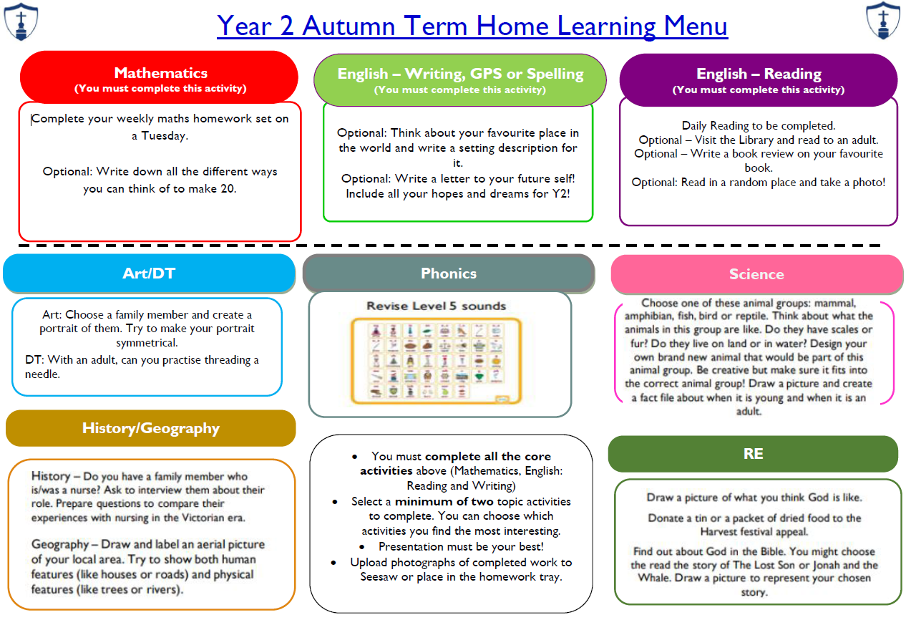
Home Learning

Slide 12
DAILY Reading / Reading Planners
  We expect that your child reads each night. Please sign their planner as soon as you have listened to them read so that we know whether they are having any difficulties and please send it into school each day.
  We award stickers and house points for regular reading.
  Comprehension skills are very important. Please discuss your child’s reading book with them and ask quiz questions about the text they have read.
  We share many texts in Year 2. If children have a favourite text they are reading at home, they can bring this into school.
  Our aim is to promote a love of reading.
  Classes will be given time each week to use our library. Library books will be changed on Wednesday along with home reading books.

Slide 13
INSPECTION FINDINGS
Our latest inspections from SIAMS (March 2026) and OFSTED (April 2026) are available to view on our website.
We were incredibly proud of our children and our staff during both inspections.
The OFSTED inspectors said they would send their children to St Chad’s! ☺☺☺
Please share this positivity in the community!
“There is a very strong culture in the school of deep respect and care which supports the wellbeing of pupils and adults.” (SIAMS 2026)

Slide 14
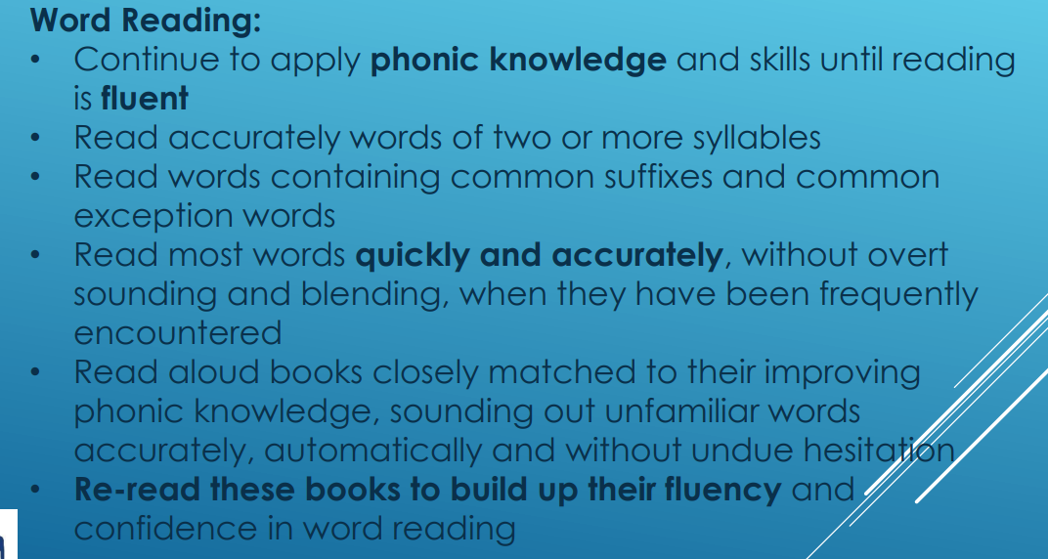
Expected Outcomes for Year 2 in Reading

Slide 15

Expected Outcomes for Year 2 in Reading (cont.)

Slide 16

Expected Outcomes for Year 2 in Writing

Slide 17

Expected Outcomes for Year 2 in Writing (cont.)

Slide 18
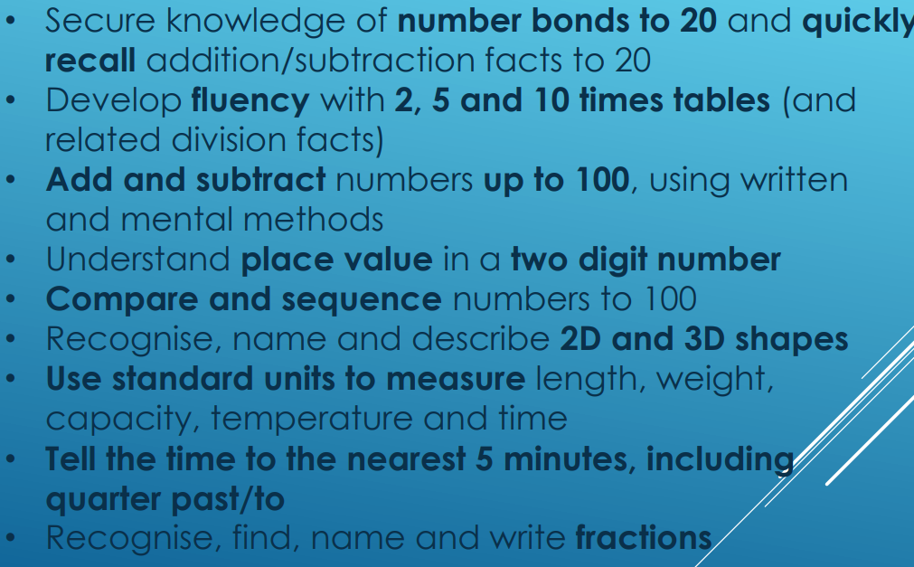
Expected Outcomes for Year 2 in Maths

Slide 19
Staying safe online
Link to website
https://poultonstchadsce.lancs.sch.uk/esafety-children/
As a school we are continually mindful of the online world that children today are exposed to. We take strong measures to support our children in developing the tools to use devices safely and responsibly. This includes…
-Use of the Purplemash 2BeSafe Scheme, which runs through the year and covers eight areas outlined by the UK Council for Online Safety.
-Frequent updates to our Online Safety Policy, this is shared with the children and created in collaboration with School Council.
-Rigorous monitoring both by staff and leadership of all devices.
If you have any concerns or questions regarding Online Safety you are able to contact your class teacher via Seesaw.

Slide 20
Statutory Tests
Year 1 Phonics Screening wc Monday 9th June
Year 4 MTC wc Monday 7th June (Tuesday 8th June for us)
Year 6 SATS wc Monday 10th May
There are no statutory tests in Y2,Y3 or Y5 but we will be beginning to prepare for the SATS at the end of KS2.

Slide 21
Enrichment Activities
There will continue to be a range of extra curricular activities available to Year 2.
I shall be running golf and a speedstacking club this year. Miss Eggleston will also be offering an art club.
We had 28 clubs for children last year and we went on 27 trips!

Slide 22
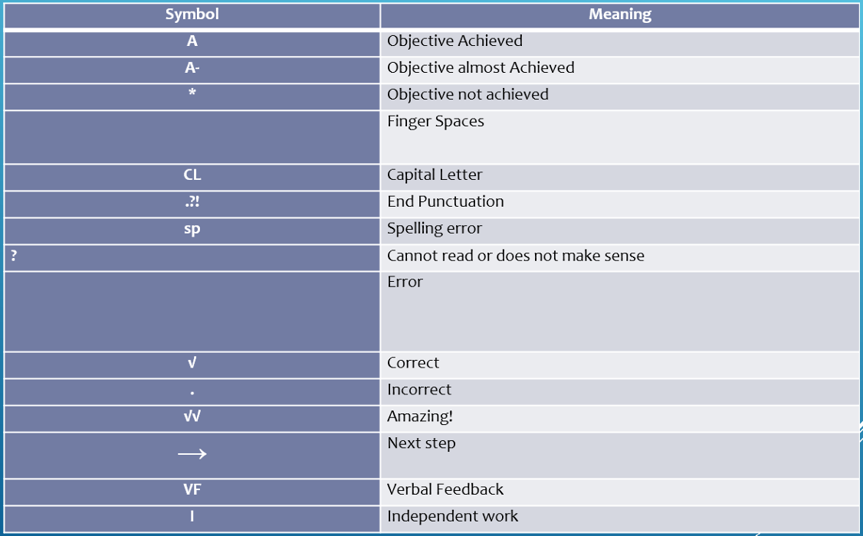
KS1 Marking Policy
Our full marking policy can be found on our website

Slide 23

Reporting to Parents
Autumn Term 2026/27:
Parent’s Evening on Monday 19th and Thursday 22nd October
Spring Term 2026/27:
Parent’s Evening on Monday 8th and Thursday 11th February
Summer Term 2026/27:
End of Year Reports on Wednesday 14th July
“The school have been incredibly supportive; they clearly care about the children. We’re really happy with how our son is progressing at St Chads, it’s a great environment for him.” (Ofsted Parent View 2026)

Slide 24

Open door policy
St Chad’s operates an open door policy. If you have an issue or concern, please discuss it firstly with the class teacher.
First thing in the morning when the door is opened or when the teacher is seeing the children out at the end of day, is not always the most convenient time to discuss concerns.
You can call the office or send the teacher a message to make an appointment or ask for a call back.
We will always respond within 48 hours.
In the rare event that the matter cannot be resolved with the teacher, please contact the Key Stage Leader (EYFS/KS1 Mrs Harwood or KS2 Mr Blackburn).
If there is still no resolution, then please contact Mrs Bitsakaki.

Slide 25
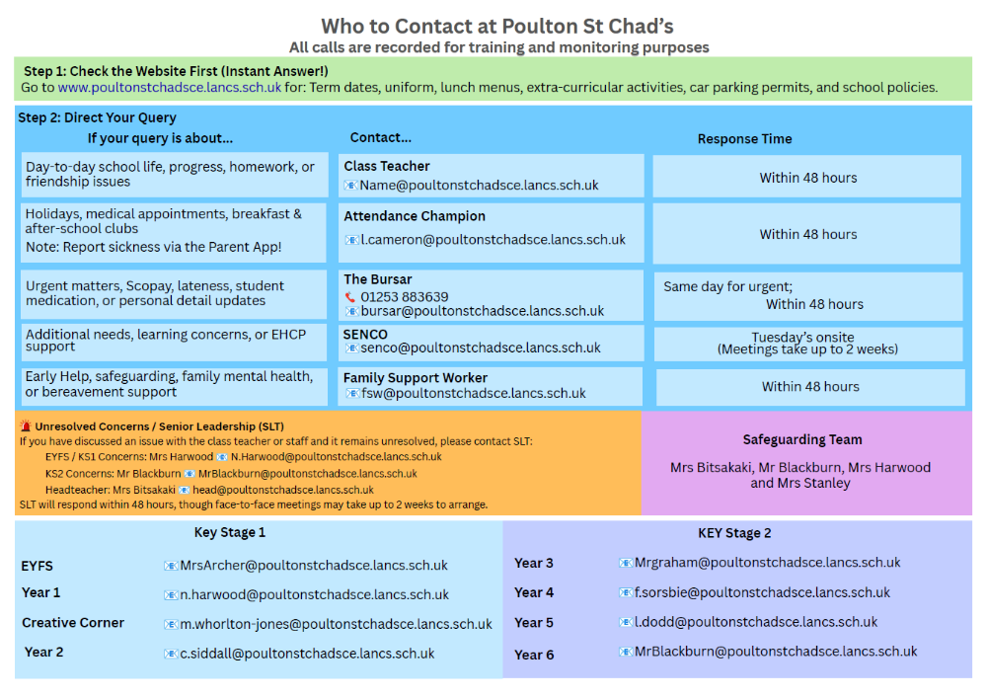
Who to contact

Slide 26
HOW CAN YOU SUPPORT?
Our Home School Agreement is in the front of your child’s planner which gives you an idea of how you can help.
If your child has any change in circumstances that might affect their wellbeing or learning, please let us know.
We would love you to engage positively with social media- we regularly post on Facebook and we really appreciate any likes and shares and positive comments on public forums such as Poulton Chat.
Please avoid posting negative comments on social media or class Whatsapp groups as this can really damage relationships. We ask that if you have any concerns, you contact us so we can resolve issues together.

Slide 27
A day in the life of year 2
https://poultonstchadsce.lancs.sch.uk/year-2/

Slide 28
Thank You
Any questions?
LOVE LEARNING. LOVE GOD. LOVE ONE ANOTHER.
“Let all that you do be done in love” (1Corinthians 16:14)
“Staff know pupils well and nurture positive, respectful relationships with them.” (Ofsted 2026)

