Slide 1

LOVE LEARNING. LOVE GOD. LOVE ONE ANOTHER.
“Let all that you do be done in love” (1 Corinthians 16:14)
At Poulton St Chad’s, we believe every child is a gift from God, blessed with their own gifts and talents. It is our mission to ensure children are safe, happy and can thrive. We aim to give our children a love for learning through our engaging curriculum and enrichment opportunities; a love for God within our distinctly Christian setting and a love for one another through our nurturing environment and inclusive relationships.

Slide 2

Welcome
“Would 100% recommend St Chads. They have been a great school for our family!” (Ofsted Parent View 2026)
Year 4
Mr Sorsbie

Slide 3

Practicalities
Please label all of your child’s uniform and their packed lunch box so it is easier to return if lost.
Your child should have a waterproof coat with a hood in school.
All children should have a named water bottle which contains only water.
KS2 Snack Bar is available at break time. At the request of the children, they can buy juice cartons, raisins, fruit, crumpets, pancakes, muffins (Tuesday) and toast (Friday) for 20p-40p.
Bacon/sausage barmcakes are available on a Wednesday for £2

Slide 4
Practicalities continued
If someone different is picking your child up, please phone the office in advance so that they can inform their class teacher.
School starts at 8.55am. The gate opens at 8:40am.
Please drop your child off at the outside door. If your child is late they must enter school via the office and a late form completed by an adult.
School finishes at 3.10 for EYFS- Year 3 and 3.15pm for Years 4-6 (at the request of parents).

Slide 5
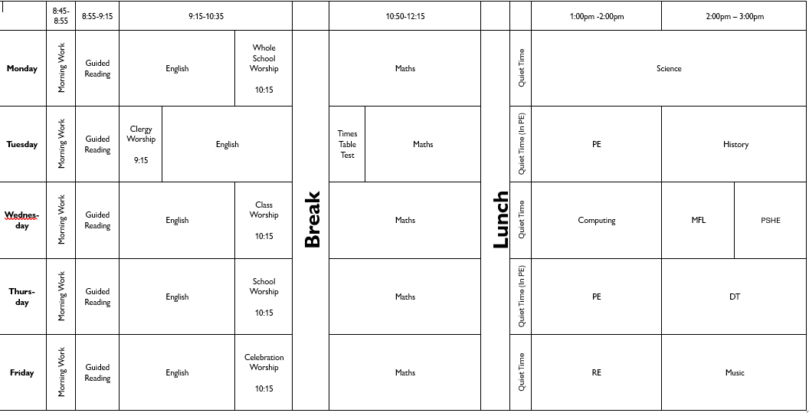

Daily Timetable

Slide 6
P.E.
In Year 4, your child will have P.E on Tuesdays and Thursdays . Please ensure that they come dressed in P.E kit on these days.
Year 4 will go swimming in the pop-up pool in February.
Jewellery must not be worn for PE (earrings must be covered with plasters or taken out by the child)
Long hair must be tied back during school and all P.E lessons (only plain navy or blue hairbands are acceptable).
All children with long hair require a swimming cap.

Slide 7
Behaviour
”pupils behave well and show great respect for one another” (OFSTED 2026)
We ask that parents support our Behaviour and Relationships policy, which is available on our website.
It is important that we work together as a partnership and that you understand how behaviour issues are dealt with at school.
At St Chad’s we promote positive behaviour throughout and we have many positive reinforcements in place. For example in Year 4, we reward with a recognition board, and our weekly raffle. All children receive house points and weekly winners receive an extra playtime.
Children are also chosen for Star Of The Week and Learner Of the Week Awards. We have the Floki award and the Class of the Week award!
Our Head Boy and Girl and our Deputy Head Boy and Girl promote positive behaviour.
We always try to catch children being good!

Slide 8
Behaviour Continued
We now have regulation stations throughout school in case children need a few moments to try and regulate themselves.
If your child demonstrates poor behaviour in class, they will be given a warning. If their behaviour does not improve and they have moved through the different levels of the behaviour policy, then they will speak to their class teacher during ‘Quiet Time’ and parents will be contacted if this is repeated.
We ask parents to avoid trying to reverse a decision made in school as this can be very unhelpful for your child.
Please contact the class teacher if you have any concerns about your child’s behaviour.

Slide 9
Attendance- 98%
We have updated our attendance policy which is on the website- our target is now 98%. As part of our whole-school approach to achieving this target, we are introducing a termly attendance rewards programme.
Children who meet the agreed attendance criteria will receive a Bronze, Silver, or Gold Attendance Certificate each term
All children who achieve the relevant attendance threshold will be entered into a prize draw at the end of each term, giving them the opportunity to win a special reward.
There will also be a weekly attendance prize for the class with the highest attendance. We hope this initiative will encourage excellent attendance and celebrate the positive efforts of our pupils and families.
100% excellent | 98-99% meeting school target | 96-97% close to school target Phone call + letter | 90-95% below school target (cause for concern) Parent contract | Below 89% Persistent Absence- (SA= 50% and below)

Slide 10
Home Learning
  Your child ‘s Creative Home Learning Menu is now available on the school website.
  The termly Newsletter explaining what the children will be learning about in each subject is also on the Y4 page on the website.
  We will have a ‘Come Discover with Me’ session on Monday 28th September.

Slide 11
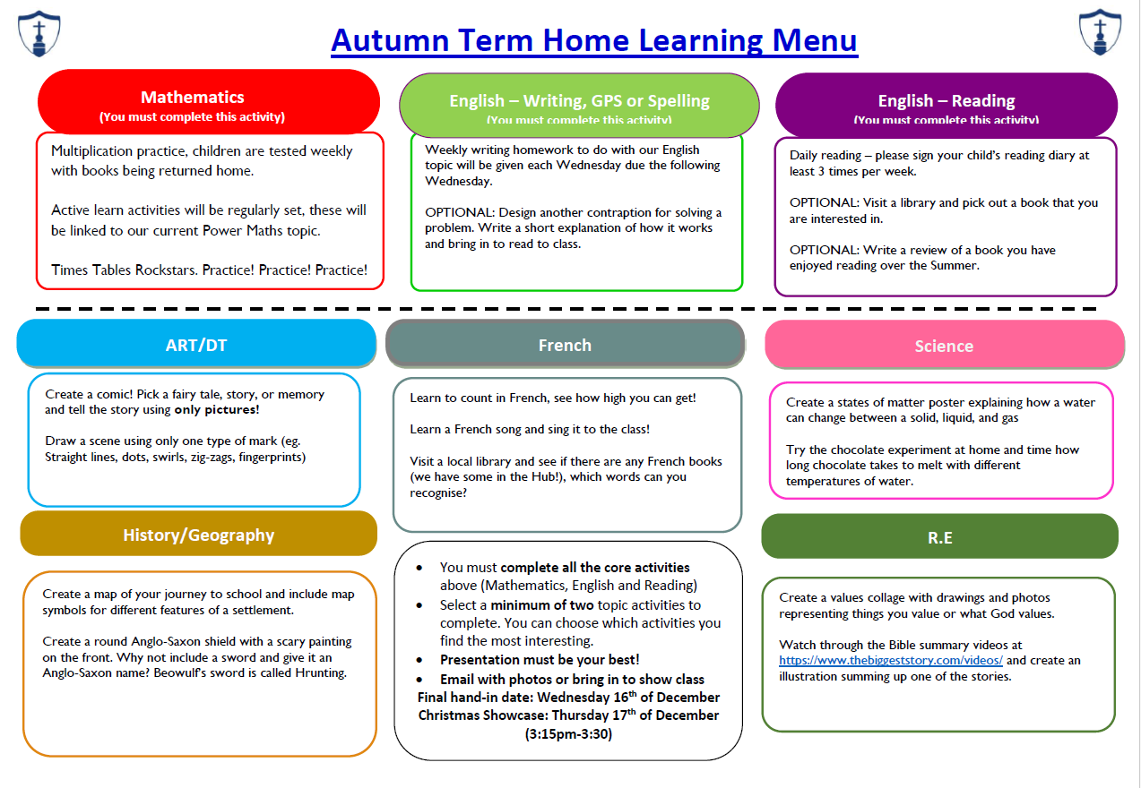
Home Learning

Slide 12
DAILY Reading
  We expect that your child reads each night. Please sign their planner as soon as you have listened to them read so that we know whether they are having any difficulties and please send it into school each day.
  We award stickers and house points for regular reading.
  Children who haven’t read at home will be given reading time in the Hub on a Friday breaktime.
  Comprehension skills are very important. Please discuss your child’s reading book with them and ask quiz questions about the text they have read.
  We now have a class text that we shall be reading for fun each half term.
  Our aim is to promote a love of reading.
  Classes will be given time each week to use our library.

Slide 13
INSPECTION FINDINGS
Our latest inspections from SIAMS (March 2026) and OFSTED (April 2026) are available to view on our website.
We were incredibly proud of our children and our staff during both inspections.
The OFSTED inspectors said they would send their children to St Chad’s! ☺☺☺
Please share this positivity in the community!
“There is a very strong culture in the school of deep respect and care which supports the wellbeing of pupils and adults.” (SIAMS 2026)

Slide 14
Expected Outcomes for Year 4 in Reading
Read with fluency a range of age-appropriate text types from those specified for YRs 3 and 4 (including fairy stories, myths and legends, poetry, plays and non-fiction books).
Read at a speed sufficient for them to focus on understanding.
Read most common exception words effortlessly, noting unusual correspondence between spelling and sound.
Know the full range of GPCs, and use phonic skills consistently and automatically to address unfamiliar or challenging words.
Determine the meaning of new words by sometimes applying knowledge of root words and their affixes e.g. information, invasion, enclosure, mountainous.
Prepare poems and play scripts to read aloud and perform.
Demonstrate understanding by using appropriate intonation and volume when reciting or reading aloud.

Slide 15
Expected Outcomes for Year 4 in Reading (cont.)
Fully engage with and enjoy reading a range of texts.
Listen to, discuss and express views about a wide range of fiction
(including fairy stories, myths and legends over the two YR cycle), poetry (including those read aloud and performed) and plays.
Begin to justify comments.
Listen to and discuss a range of non-fiction and reference or text books, that are structured in different ways; recognise typical presentational features.
Identify themes and conventions in a range of books e.g. identify a theme of ‘recycling’ or ‘changes in leisure activities’; recognise the conventions of a myth or play script; know how information is signposted in reference books.
Recognise several different forms of poetry, such as free verse, rhyming, shape, narrative, humorous; explain their differences.
Draw inferences and justify with evidence e.g. characters’ feelings, thoughts and motives, from their actions or words.
Draw comparisons.
Predict what might credibly happen from details stated and implied.

Slide 16
Expected Outcomes for Year 4 in Writing
Create correctly punctuated fronted adverbials.
Use commas to mark clauses in complex sentences.
Use inverted commas and other punctuation to indicate direct speech.
Explore, identify and use Standard English verb inflections for writing.
Use apostrophes for regular plural possession.
Discussing and recording ideas for planning.
Develop settings and characterisation using vocabulary to create emphasis, humour, atmosphere and suspense.

Slide 17
Expected Outcomes for Year 4 in Writing (cont.)
Planning and writing an opening paragraph which combines the introduction of a setting and characters.
Organising paragraphs in narrative and non-fiction.
Proofreading to check for errors in spelling, grammar and punctuation in own and others’ writing.
Use the first three letters of a word to check its spelling in the dictionary.
Spell some homophones and commonly misspelt words correctly.
Increase the legibility, consistency and quality of handwriting.

Slide 18
Expected Outcomes for Year 4 in Maths
To know that 10 hundreds are equivalent to 1 thousand, and that 1,000 is 10 times the size of 100.
To apply this to identify and work out how many 100s there are in other four-digit multiples of 100.
To read and write numbers to 10,000, recognise the place value in a four-digit number, and compose and decompose four-digit numbers using standard and nonstandard partitioning.
To reason about the location of any four-digit number in the linear number system, including identifying the previous and next multiple of 1,000 and 100, and rounding to the nearest of each.
To divide 1,000 into 2, 4, 5 and 10 equal parts, and read scales/number lines marked in multiples of 1,000 with 2, 4, 5 and 10 equal parts.
To recall and use multiplication and division facts for x tables to 12 x 12.
To solve division problems, with two-digit dividends and one-digit divisors, that involve remainders, and interpret remainders appropriately according to the context.
To x and ÷ two-digit numbers by 10 and 100 (keeping to whole number quotients).

Slide 19
Expected Outcomes for Year 4 in Maths (cont.)
To manipulate multiplication and division equations, and understand and apply the commutative property of multiplication
To understand and apply the distributive property of multiplication.
To reason about the location of mixed numbers in the linear number system.
To convert mixed numbers to improper fractions and vice versa.
To add and subtract improper and mixed fractions with the same denominator, including bridging whole numbers.
To draw polygons, specified by coordinates in the first quadrant and translate within the first quadrant.
To identify regular polygons, including equilateral triangles and squares, as those in which the side-lengths and angles are equal.

Slide 20
Staying safe online
Link to website
https://poultonstchadsce.lancs.sch.uk/safeguarding-children/
As a school we are continually mindful of the online world that children today are exposed to. We take strong measures to support our children in developing the tools to use devices safely and responsibly. This includes…
-Use of the Purplemash 2BeSafe Scheme, which runs through the year and covers eight areas outlined by the UK Council for Online Safety.
-Frequent updates to our Online Safety Policy, this is shared with the children and created in collaboration with School Council.
-Rigorous monitoring both by staff and leadership of all devices.
If you have any concerns or questions regarding Online Safety you are able to contact your class teacher via Seesaw.

Slide 21
Statutory Tests
Year 1 Phonics Screening wc Monday 9th June
Year 4 MTC wc Monday 7th June (Tuesday 8th June for us)
Year 6 SATS wc Monday 10th May
There are no statutory tests in Y2,Y3 or Y5 but we will be beginning to prepare for the SATS at the end of KS2.

Slide 22
Enrichment Activities
There will continue to be a range of extra curricular activities available to Year 4.
I am running ETHOS gain this year.
Mr Blackburn and Mr Graham have started up Chess Club.
We had 28 clubs for children last year and we went on 27 trips!

Slide 23
KS2 Marking Policy
Our full marking policy can be found on our website
Symbol | Meaning
A | Objective Achieved
A- | Objective almost Achieved
* | Objective not achieved
____sp | Try spelling this word again
? | Does not make sense/ meaning is unclear
P | Find and include the missing punctuation on this line
// | A new paragraph is needed
“ | Speech marks are missing or used incorrectly.
^ | A word or letter has been missed out
 | Error to be checked
√ | Correct
. | Incorrect
√√ | Amazing!
→ | Next step
VF | Verbal Feedback

Slide 24

Reporting to Parents
Autumn Term 2026/27:
Parent’s Evening on Monday 19th and Thursday 22nd October
Spring Term 2026/27:
Parent’s Evening on Monday 8th and Thursday 11th February
Summer Term 2026/27:
End of Year Reports on Wednesday 14th July
“The school have been incredibly supportive; they clearly care about the children. We’re really happy with how our son is progressing at St Chads, it’s a great environment for him.” (Ofsted Parent View 2026)

Slide 25

Open door policy
St Chad’s operates an open door policy. If you have an issue or concern, please discuss it firstly with the class teacher.
First thing in the morning when the door is opened or when the teacher is seeing the children out at the end of day, is not always the most convenient time to discuss concerns.
You can call the office or send the teacher a message to make an appointment or ask for a call back.
A quick message to the teacher via SeeSaw is fine. However, we prefer not to communicate via SeeSaw or email over serious issues or concerns - these are always best dealt with in person or over the phone.
We will always respond within 48 hours.
In the rare event that the matter cannot be resolved with the teacher, please contact the Key Stage Leader (EYFS/KS1 Mrs Harwood or KS2 Mr Blackburn).
If there is still no resolution, then please contact Mrs Bitsakaki.

Slide 26
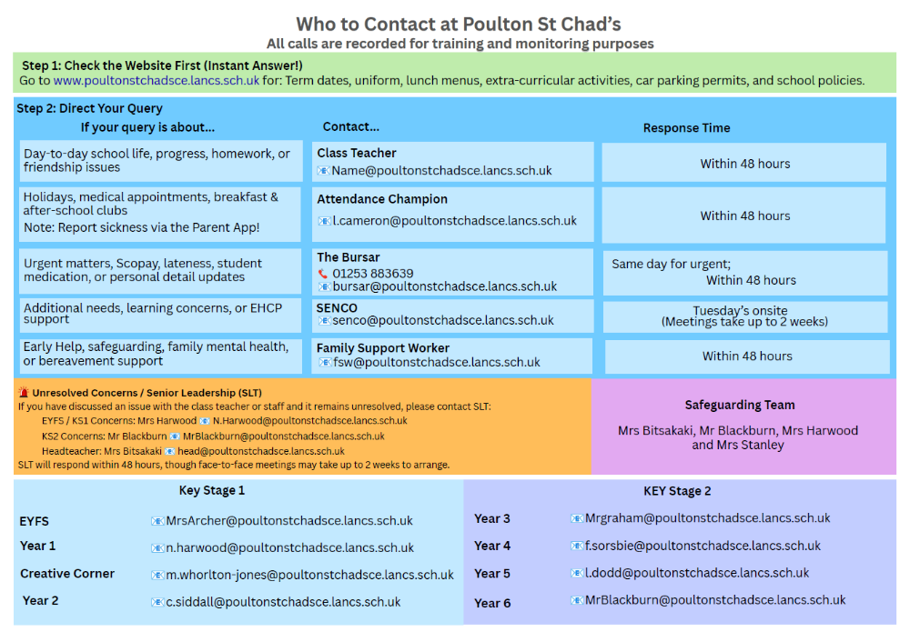
Who to contact
SeeSaw Message

Slide 27
HOW CAN YOU SUPPORT?
Our Home School Agreement is in the front of your child’s planner which gives you an idea of how you can help.
If your child has any change in circumstances that might affect their wellbeing or learning, please let us know.
We would love you to engage positively with social media- we regularly post on Facebook and we really appreciate any likes and shares and positive comments on public forums such as Poulton Chat.
Please avoid posting negative comments on social media or class Whatsapp groups as this can really damage relationships. We ask that if you have any concerns, you contact us so we can resolve issues together.

Slide 28
A day in the life of year 4
poultonstchadsce.lancs.sch.uk/wp-content/uploads/2026/09/Year-4-Video-1.mp4

Slide 29
Thank You
Any questions?
LOVE LEARNING. LOVE GOD. LOVE ONE ANOTHER.
“Let all that you do be done in love” (1Corinthians 16:14)
“Staff know pupils well and nurture positive, respectful relationships with them.” (Ofsted 2026)

