Slide 1

LOVE LEARNING. LOVE GOD. LOVE ONE ANOTHER.
“Let all that you do be done in love” (1 Corinthians 16:14)
At Poulton St Chad’s, we believe every child is a gift from God, blessed with their own gifts and talents. It is our mission to ensure children are safe, happy and can thrive. We aim to give our children a love for learning through our engaging curriculum and enrichment opportunities; a love for God within our distinctly Christian setting and a love for one another through our nurturing environment and inclusive relationships.

Slide 2

Welcome
“Would 100% recommend St Chads. They have been a great school for our family!” (Ofsted Parent View 2026)
Year 1
Mrs Harwood
email: nharwood@poultonstchadsce.lancs.sch.uk

Slide 3

Welcome to year 1
Staff
Teachers: Mrs Harwood
Mrs Whorlton-Jones (Wed & Thurs PM)
Teaching Assistants:
Mrs Miller (MON, Tues, Thurs, Fri)
Mrs Latimer (wed)
Family Support Worker: Mrs Stanley
email: lstanley@poultonstchadsce.lancs.sch.uk

Slide 4
Practicalities
Please label all of your child’s uniform and their packed lunch box so it is easier to return if lost.
Your child should have a waterproof coat with a hood in school.
All children should have a named water bottle which contains only water.

Slide 5
Practicalities continued
If someone different is picking your child up, please phone the office in advance so that they can inform their class teacher.
School starts at 8:55am. The gate opens at 8:40am.
Please drop your child at the EYFS/Year 1 gate. Children in Creative Corner should be dropped at the Creative Corner door. If your child arrives late, they must enter via the office and an adult will need to complete a late form.
School finishes at 3:10pm for EYFS/KS1.

Slide 6

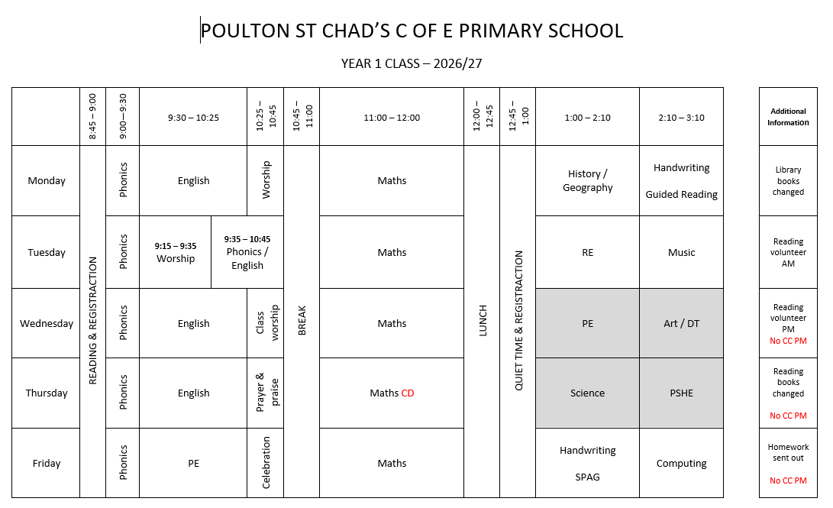
Daily Timetable

Slide 7
P.E.
In Year 1, your child will have P.E on Wednesdays and Fridays. Please ensure that they come dressed in P.E kit on these days.
Jewellery must not be worn for PE (earrings must be covered with plasters or taken out by the child)
Long hair must be tied back during school and all P.E lessons (only plain navy or blue hairbands are acceptable).

Slide 8
Behaviour
”pupils behave well and show great respect for one another” (OFSTED 2026)
We ask that parents support our Behaviour and Relationships policy, which is available on our website.
It is important that we work together as a partnership and that you understand how behaviour issues are dealt with at school.
At St Chad’s we promote positive behaviour throughout and we have many positive reinforcements in place. For example in Year 1, we reward with a recognition board and stickers. All children receive house points and weekly winners receive an extra playtime.
Children are also chosen for Star Of The Week and Learner Of the Week Awards. We have the Floki award and the Class of the Week award!
Our Head Boy and Girl and our Deputy Head Boy and Girl promote positive behaviour.
We always try to catch children being good!

Slide 9
Behaviour Continued
We now have regulation stations throughout school in case children need a few moments to try and regulate themselves.
If your child demonstrates poor behaviour in class, they will be given a warning. If their behaviour does not improve and they have moved through the different levels of the behaviour policy, then they will speak to their class teacher during ‘Quiet Time’ and parents will be contacted if this is repeated.
We parents to avoid trying to reverse a decision made in school as this can be very unhelpful for your child.
Please contact the class teacher if you have any concerns about your child’s behaviour.

Slide 10
Attendance- 98%
We have updated our attendance policy which is on the website- our target is now 98%. As part of our whole-school approach to achieving this target, we are introducing a termly attendance rewards programme.
Children who meet the agreed attendance criteria will receive a Bronze, Silver, or Gold Attendance Certificate each term
All children who achieve the relevant attendance threshold will be entered into a prize draw at the end of each term, giving them the opportunity to win a special reward.
There will also be a weekly attendance prize for the class with the highest attendance. We hope this initiative will encourage excellent attendance and celebrate the positive efforts of our pupils and families.
100% excellent | 98-99% meeting school target | 96-97% close to school target Phone call + letter | 90-95% below school target (cause for concern) Parent contract | Below 89% Persistent Absence- (SA= 50% and below)

Slide 11
Home Learning
  Your child ‘s Creative Home Learning Menu is now available on the school website.
  The termly newsletter, explaining what the children will be learning about in each subject, is also on the Y1 page on the website.
  English and Maths homework is sent home on a Friday and should be returned by the following Friday.
  We have a ‘Come Discover with Me: Phonics’ session on Friday 2nd October at 2.30pm.

Slide 12
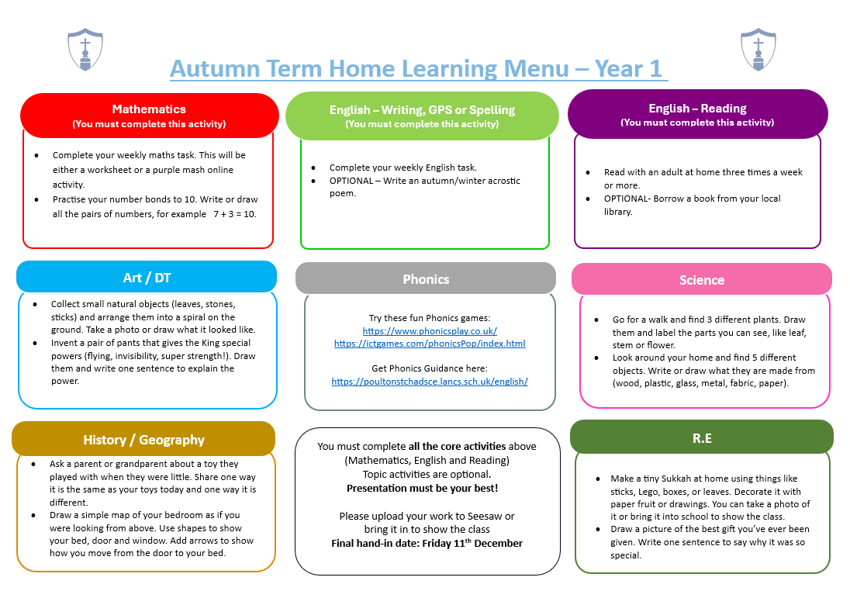
Home Learning

Slide 13
DAILY Reading
  We expect that your child reads each night. Please sign their planner as soon as you have listened to them read so that we know whether they are having any difficulties and please send it into school each day.
  We award stickers and house points for regular reading.
  If a planner isn’t signed at least three times in a week, your child will have an extra reading session and parents/carers will be contacted.
  Comprehension skills are very important. Please discuss your child’s reading book with them and ask questions about the text they have read.
  We regularly read stories to the children during the week. Our aim is to promote a love of reading.
  Every child has a library book, which they can change during our weekly library session on Mondays.

Slide 14
INSPECTION FINDINGS
Our latest inspections from SIAMS (March 2026) and OFSTED (April 2026) are available to view on our website.
We were incredibly proud of our children and our staff during both inspections.
The OFSTED inspectors said they would send their children to St Chad’s! ☺☺☺
Please share this positivity in the community!
“There is a very strong culture in the school of deep respect and care which supports the wellbeing of pupils and adults.” (SIAMS 2026)

Slide 15
Expected Outcomes for Year 1 in writing
Vocabulary, Grammar and Punctuation
Use finger spaces between words.
Use capital letters at the start of sentences.
Use full stops at the end of sentences.
Begin to use question marks (?) and exclamation marks correctly (!).
Use capital letters for names of people, places, days of the week and the word ‘I’.
Use conjunctions or joining words (e.g. and, but, so)
Handwriting
Sit at the table and hold my pencil correctly.
Start and finish letters correctly.
Form capital letters correctly (e.g. A, B, C).
Write the numbers 0, 1, 2, 3, 4, 5, 6, 7, 8 and 9.
Know which letters belong to which handwriting family

Slide 16
Expected Outcomes for Year 1 in writing (Continued)
Composition
Think of a sentence and say it out loud.
Write a sentence and check if it makes sense.
Read writing aloud to others and talk about it.
Spelling
▪ Name the letters of the alphabet in order
▪ Use phonics to spell new words
▪ Spell tricky words correctly
▪ Spell words beginning un- e.g. happy, unhappy
▪ Spell words ending –s, -es, - ing, -ed, -er, -est
▪ Use some spelling rules

Slide 17
Expected Outcomes for Year 1 in Reading
Word Reading
Sound out words using the phonics taught.
Read tricky words.
Read words ending with –s, -es, - ing, -ed, -er, -est.
Read shortened words (e.g. can’t) and understand that the apostrophe is used to show the letter/s that have been missed out (e.g. can not – can’t)
Comprehension
Listen quietly to a book being read aloud.
Retell familiar stories in their own words.
Join in with things that the whole class is saying together.
Say the meanings of some words.
Check that what has been read makes sense.
Correct mistakes while reading.
Predict what could happen next in the story.
Use existing knowledge to help understand new stories.
Explain what has been read to them.
Talk about stories that have been read to them and take turns listening to what others say about them.

Slide 18
Expected Outcomes for Year 1 in Maths
Number and place value
count, read and write numbers to 100; count forwards and backwards; identify one more and one less; use number lines and understand tens and ones.
Addition and subtraction
add and subtract one-digit and two-digit numbers to 20, including 0; know and use number bonds within 20; solve simple addition and subtraction problems.
Multiplication and division
count in 2s, 5s and 10s; solve simple grouping and sharing problems using objects, pictures and arrays.
Fractions
recognise and find halves and quarters of objects, shapes and quantities.
Measurement
compare and describe length, height, weight/mass, capacity, time and money; recognise coins and notes; tell the time to the hour and half-hour.
Shape
recognise and name common 2D and 3D shapes.
Position and direction
describe position, direction and movement, including whole, half, quarter and three-quarter turns.

Slide 19
Staying safe online
Link to website
https://poultonstchadsce.lancs.sch.uk/safeguarding-children/
As a school we are continually mindful of the online world that children today are exposed to. We take strong measures to support our children in developing the tools to use devices safely and responsibly. This includes…
-Use of the Purplemash 2BeSafe Scheme, which runs through the year and covers eight areas outlined by the UK Council for Online Safety.
-Frequent updates to our Online Safety Policy, this is shared with the children and created in collaboration with School Council.
-Rigorous monitoring both by staff and leadership of all devices.
If you have any concerns or questions regarding Online Safety you are able to contact your class teacher via Seesaw.

Slide 20
Statutory Tests
Year 1 Phonics Screening W/C Monday 14th June 2027
Year 4 MTC wc Monday 7th June (Tuesday 8th June for us)
Year 6 SATS wc Monday 10th May
There are no statutory tests in Y2,Y3 or Y5 but we will be beginning to prepare for the SATS at the end of KS2.

Slide 21
Enrichment Activities
There will continue to be a range of extra curricular activities available to Year 1 .
Our first trip of the year will take place on 29th September, when we visit Rossall School for a special literary event with author Lauren Child.
We had 28 clubs for children last year and we went on 27 trips!

Slide 22

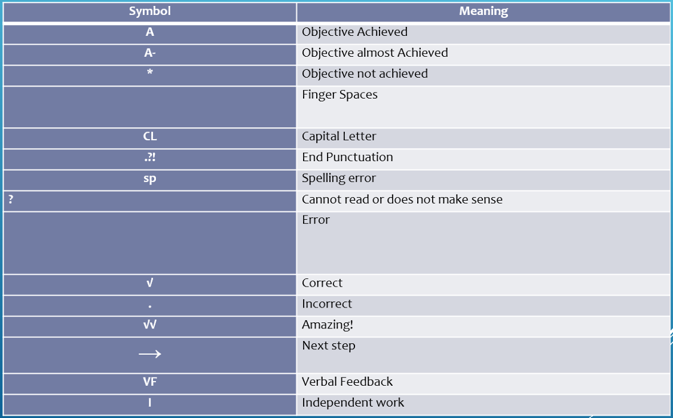
KS1 Marking Policy
Our full marking policy can be found on our website

Slide 23
Reporting to Parents
Autumn Term 2026/27:
Parent’s Evening on Monday 19th and Thursday 22nd October
Spring Term 2026/27:
Parent’s Evening on Monday 8th and Thursday 11th February
Summer Term 2026/27:
End of Year Reports on Wednesday 14th July
“The school have been incredibly supportive; they clearly care about the children. We’re really happy with how our son is progressing at St Chads, it’s a great environment for him.” (Ofsted Parent View 2026)

Slide 24
Open door policy
St Chad’s operates an open door policy. If you have an issue or concern, please discuss it firstly with the class teacher.
First thing in the morning when the door is opened or when the teacher is seeing the children out at the end of day, is not always the most convenient time to discuss concerns.
You can call the office or send the teacher a message to make an appointment or ask for a call back.
A quick message to the teacher via email is fine. However, we prefer not to communicate via email over serious issues or concerns - these are always best dealt with in person or over the phone.
We will always respond within 48 hours.
In the rare event that the matter cannot be resolved with the teacher, please contact the Key Stage Leader (EYFS/KS1 Mrs Harwood or KS2 Mr Blackburn).
If there is still no resolution, then please contact Mrs Bitsakaki.

Slide 25
Who to contact

Slide 26
HOW CAN YOU SUPPORT?
Our Home School Agreement is in the front of your child’s planner which gives you an idea of how you can help.
If your child has any change in circumstances that might affect their wellbeing or learning, please let us know.
We would love you to engage positively with social media- we regularly post on Facebook and we really appreciate any likes and shares and positive comments on public forums such as Poulton Chat.
Please avoid posting negative comments on social media or class Whatsapp groups as this can really damage relationships. We ask that if you have any concerns, you contact us so we can resolve issues together.

Slide 27
A day in the life of year 1
Day in the life video

Slide 28
Thank You
Any questions?
LOVE LEARNING. LOVE GOD. LOVE ONE ANOTHER.
“Let all that you do be done in love” (1Corinthians 16:14)
“Staff know pupils well and nurture positive, respectful relationships with them.” (Ofsted 2026)

